Slide 1
s-SNOM Measurements
October 30, 2017
Bowtie and Discrete Bowtie antennas
Under linear polarization

Slide 2
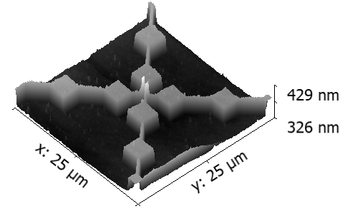
Illumination conditions
Z
Y
Incident wave θ = 60º
Light: linear polarization
Incidence: s-polarization (E vectors is parallel to the X axis)
Diodes h & g
E_{i}
θ
k-vector
X

Slide 3
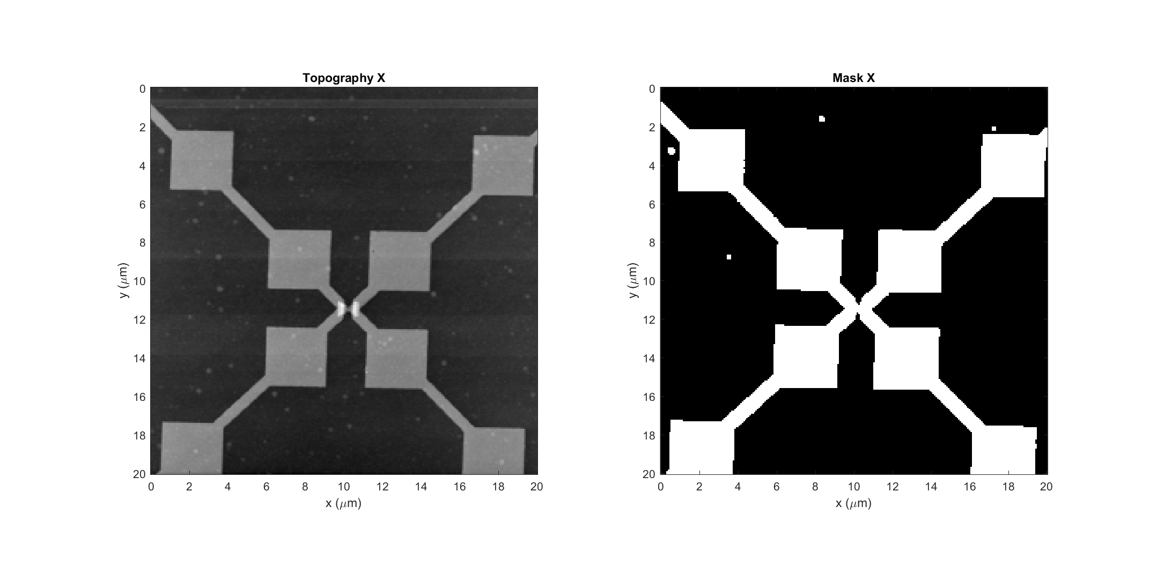
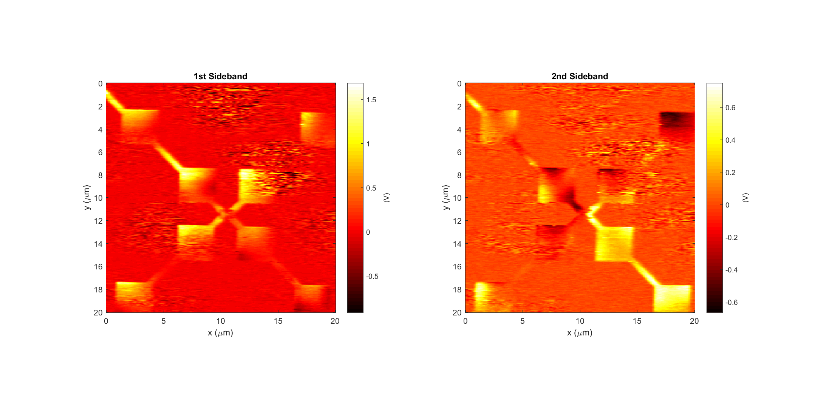
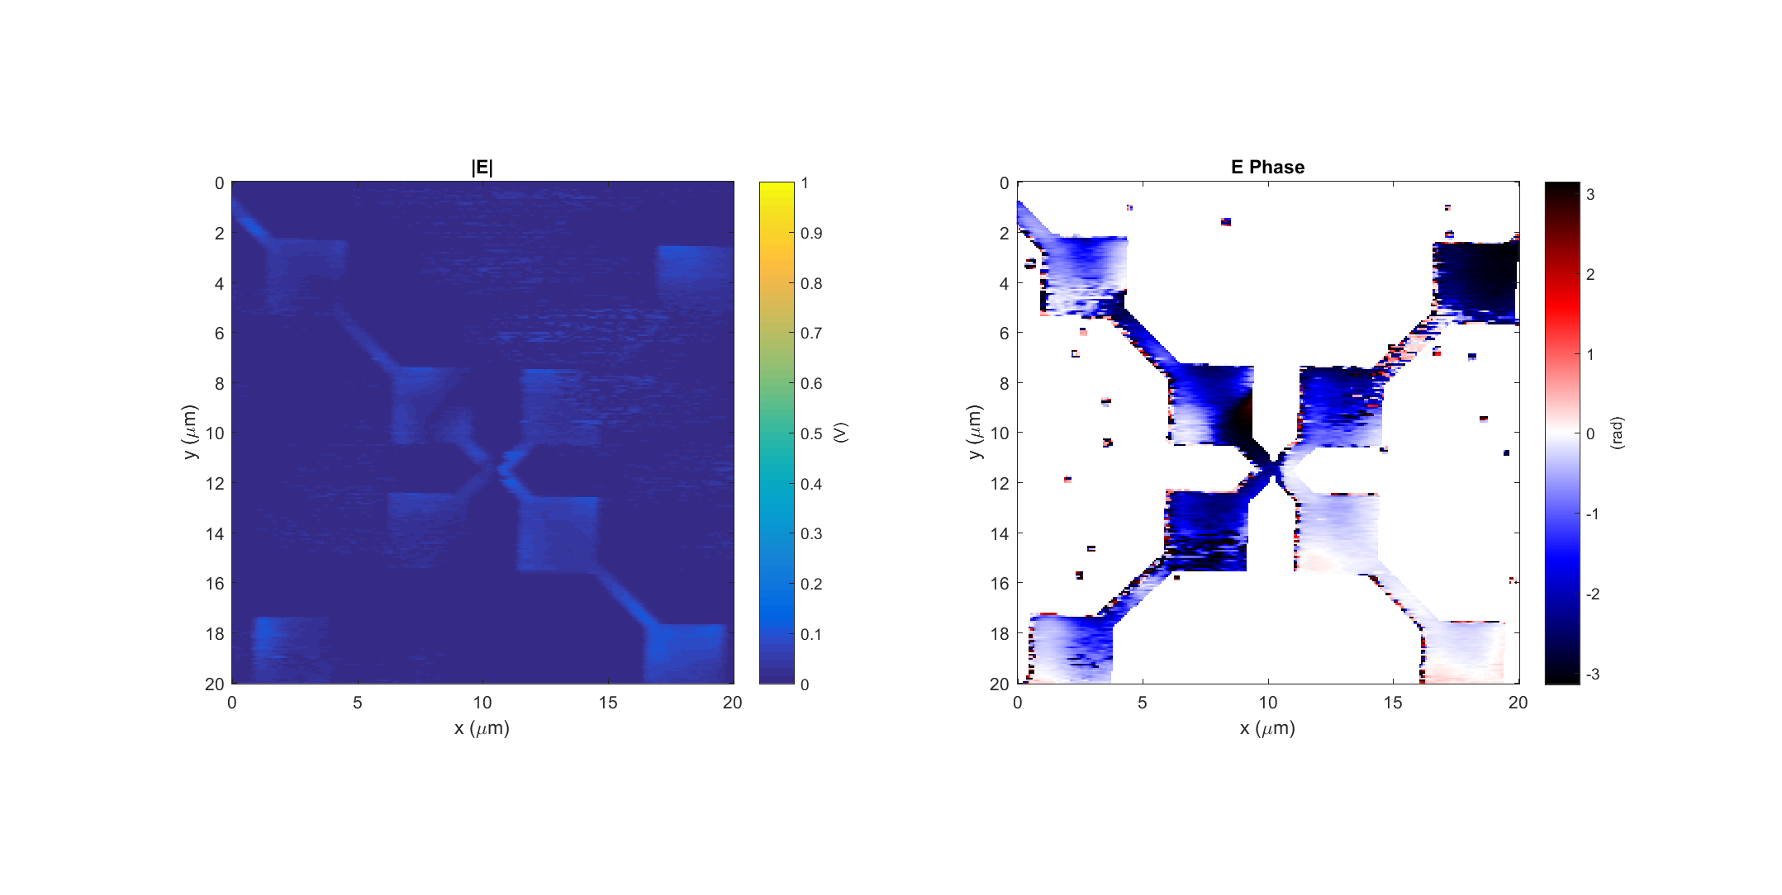
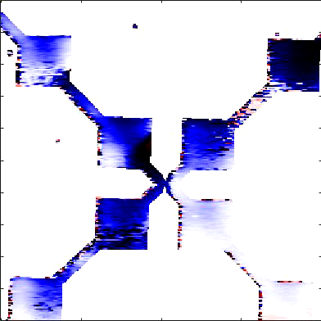
Diode h #2 (good diode) Data: 2017-11-17_diode_h_2_PH_X_2
k
Light incident from below

Slide 4
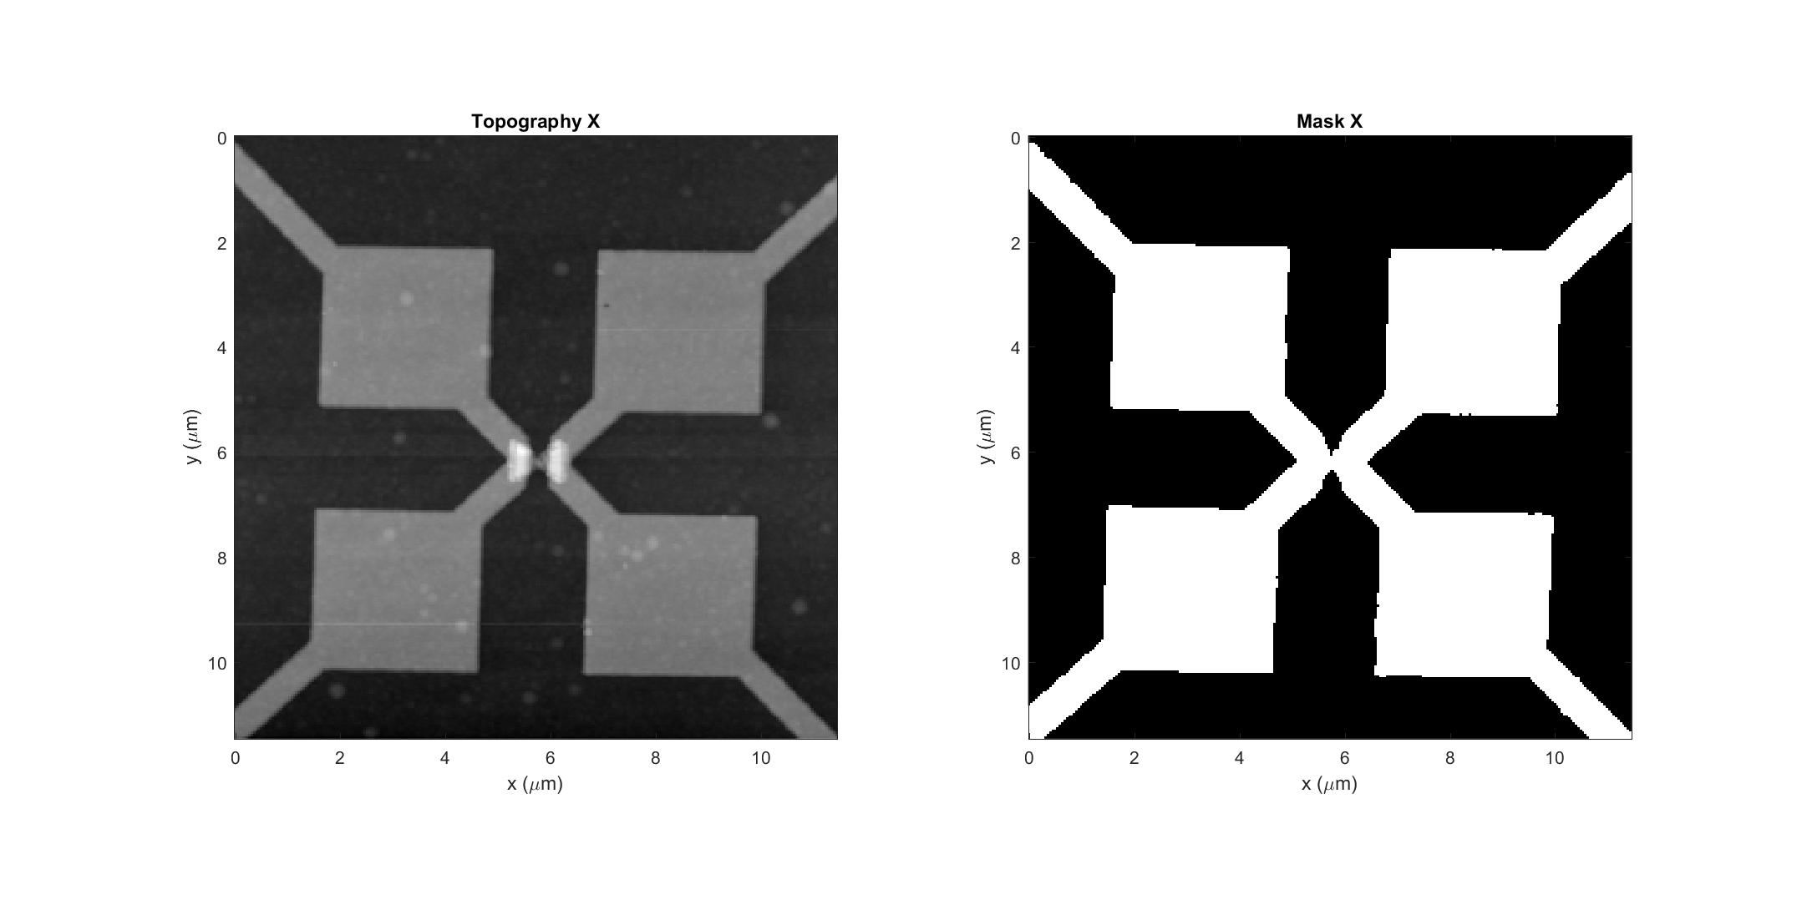
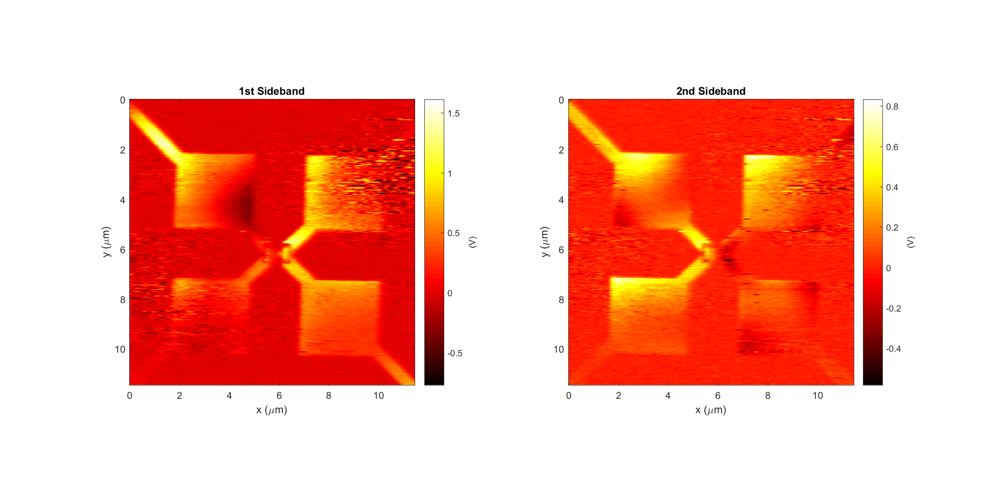
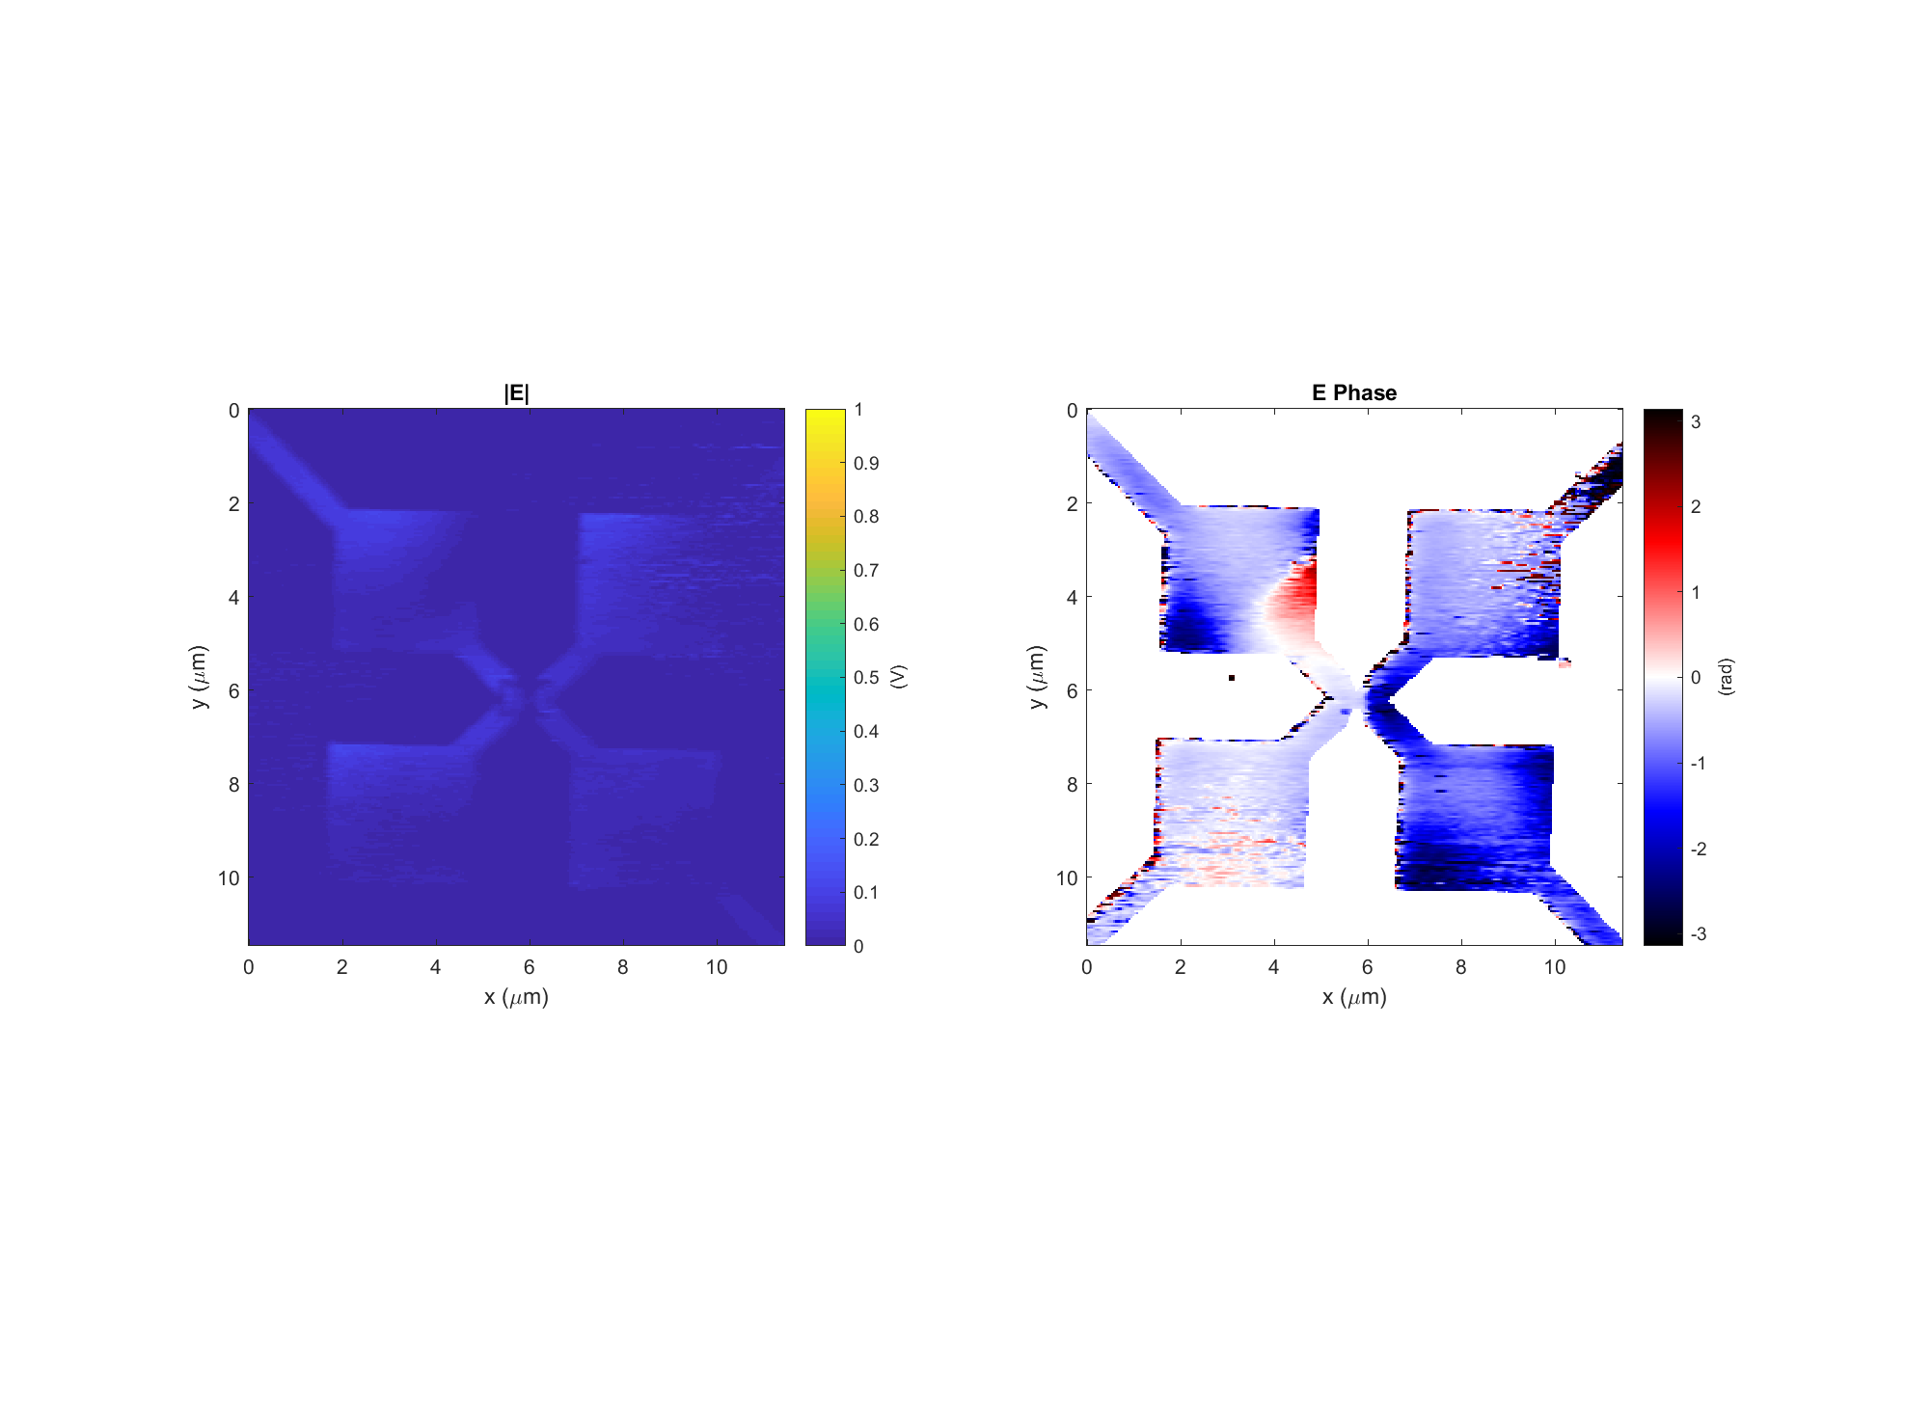
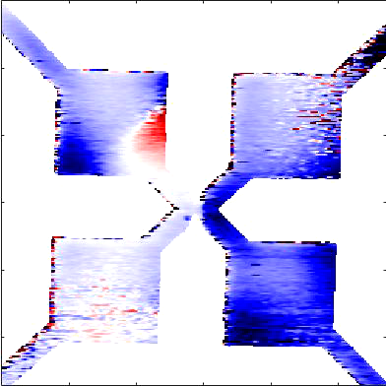
Diode h #2 (good diode) Data: 2017-11-17_diode_h_2_PH_X_3
k
Light incident from below

Slide 5
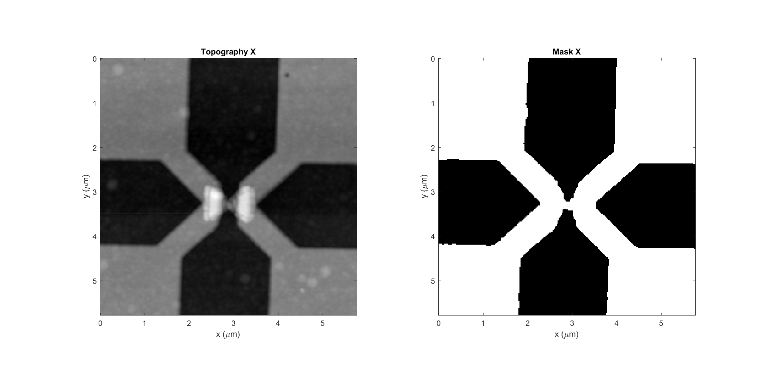
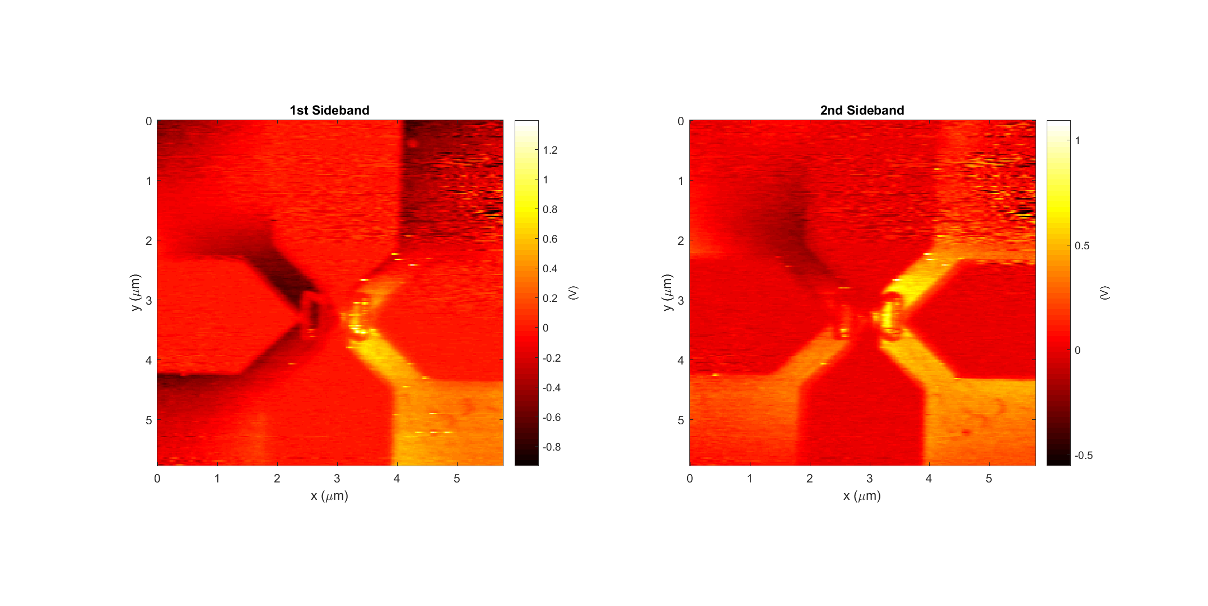
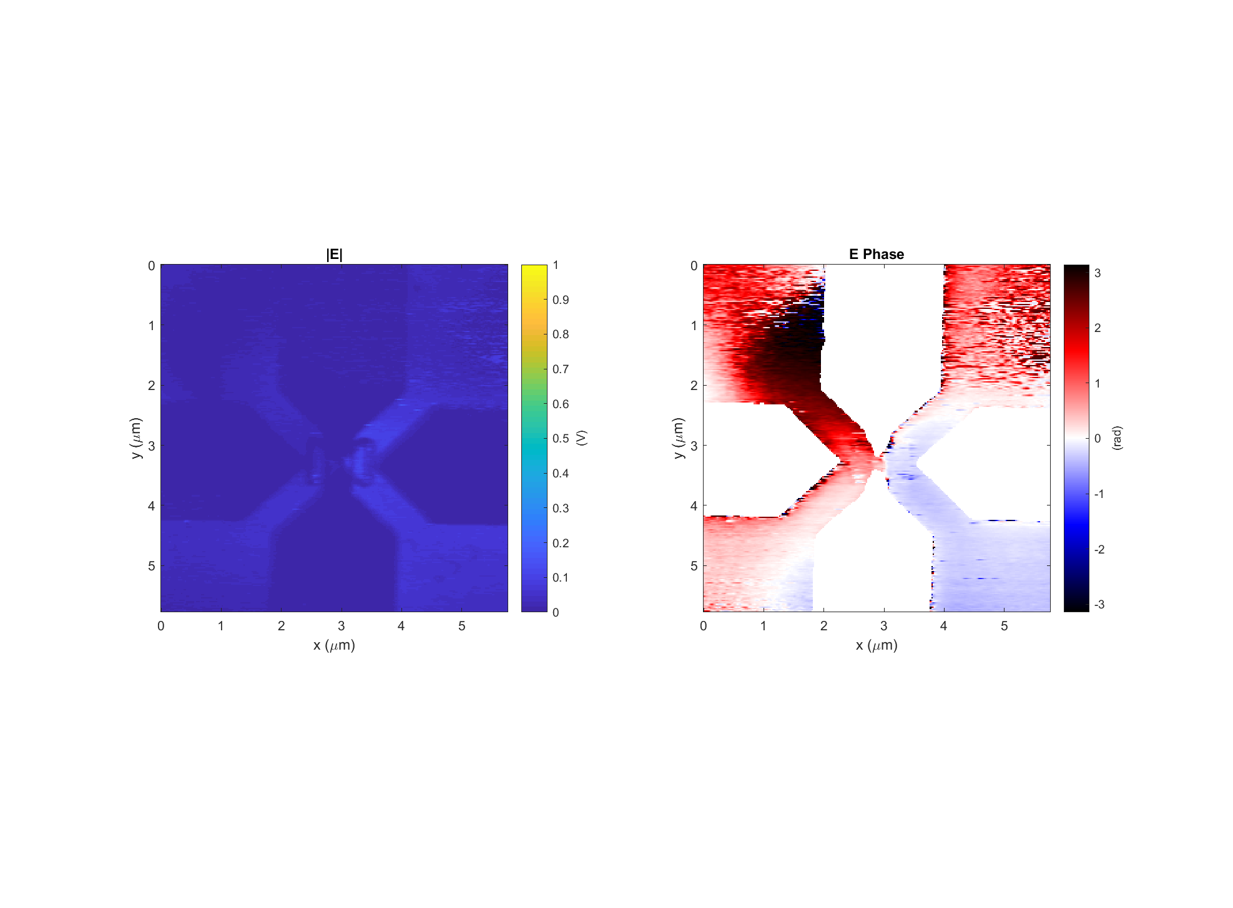
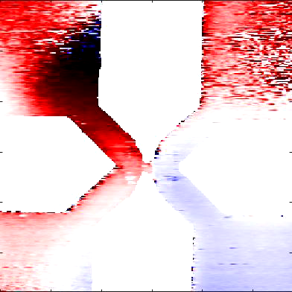
Diode h #2 (good diode) Data: 2017-11-17_diode_h_2_PH_X_4
k
Light incident from below

Slide 6
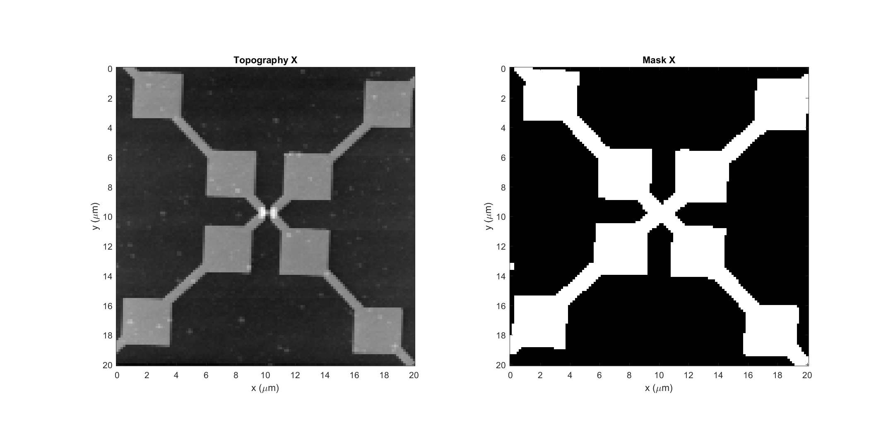
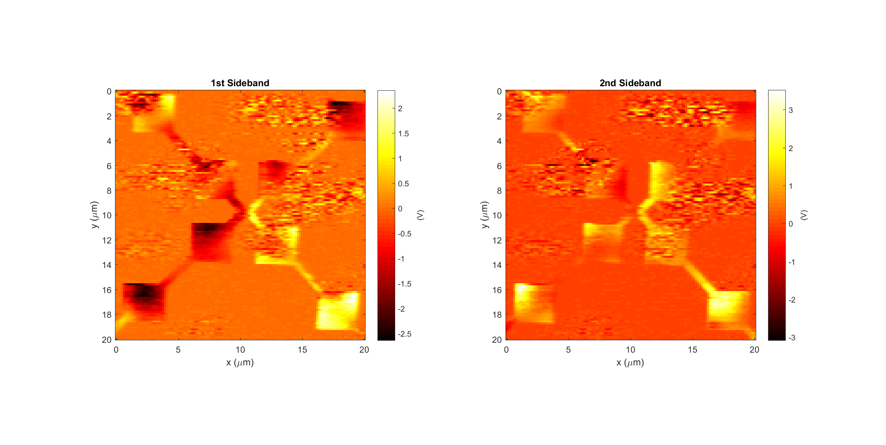
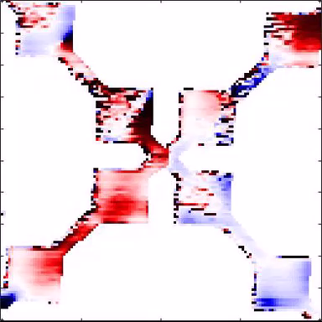
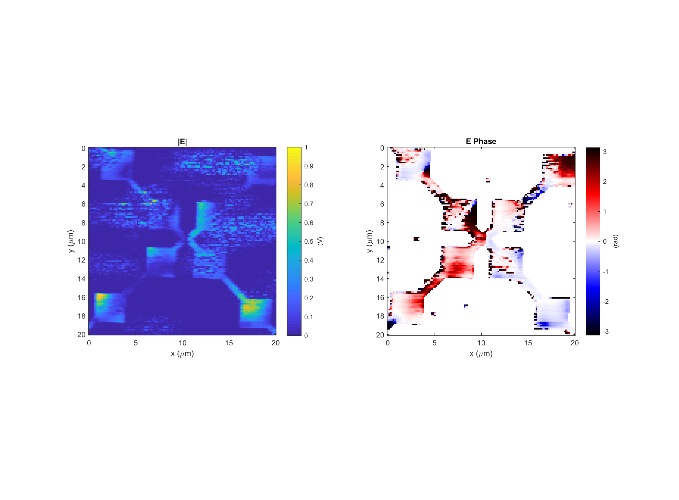
Diode h #3 (good diode) Data: 2017-11-20_diode_h_3_PH_X_1
k
Light incident from below

Slide 7
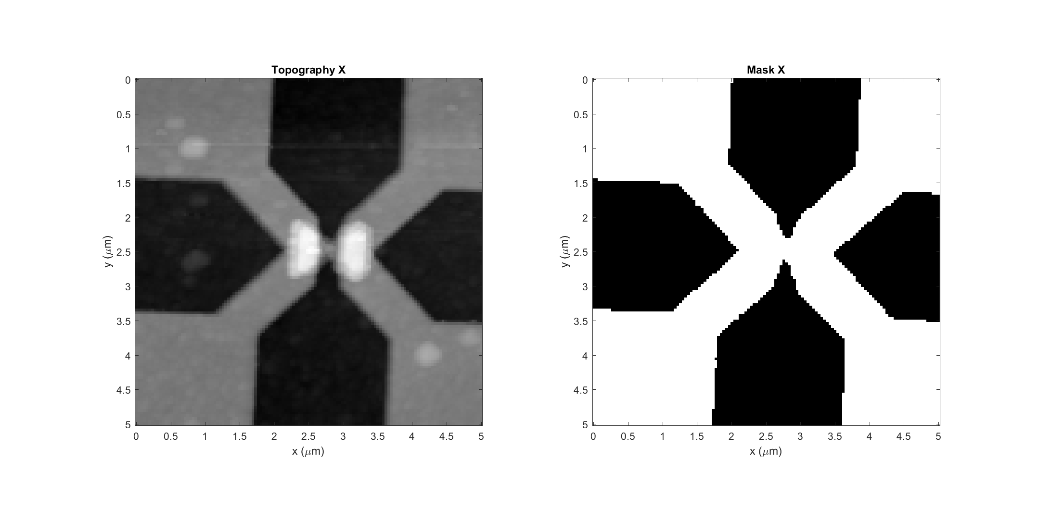
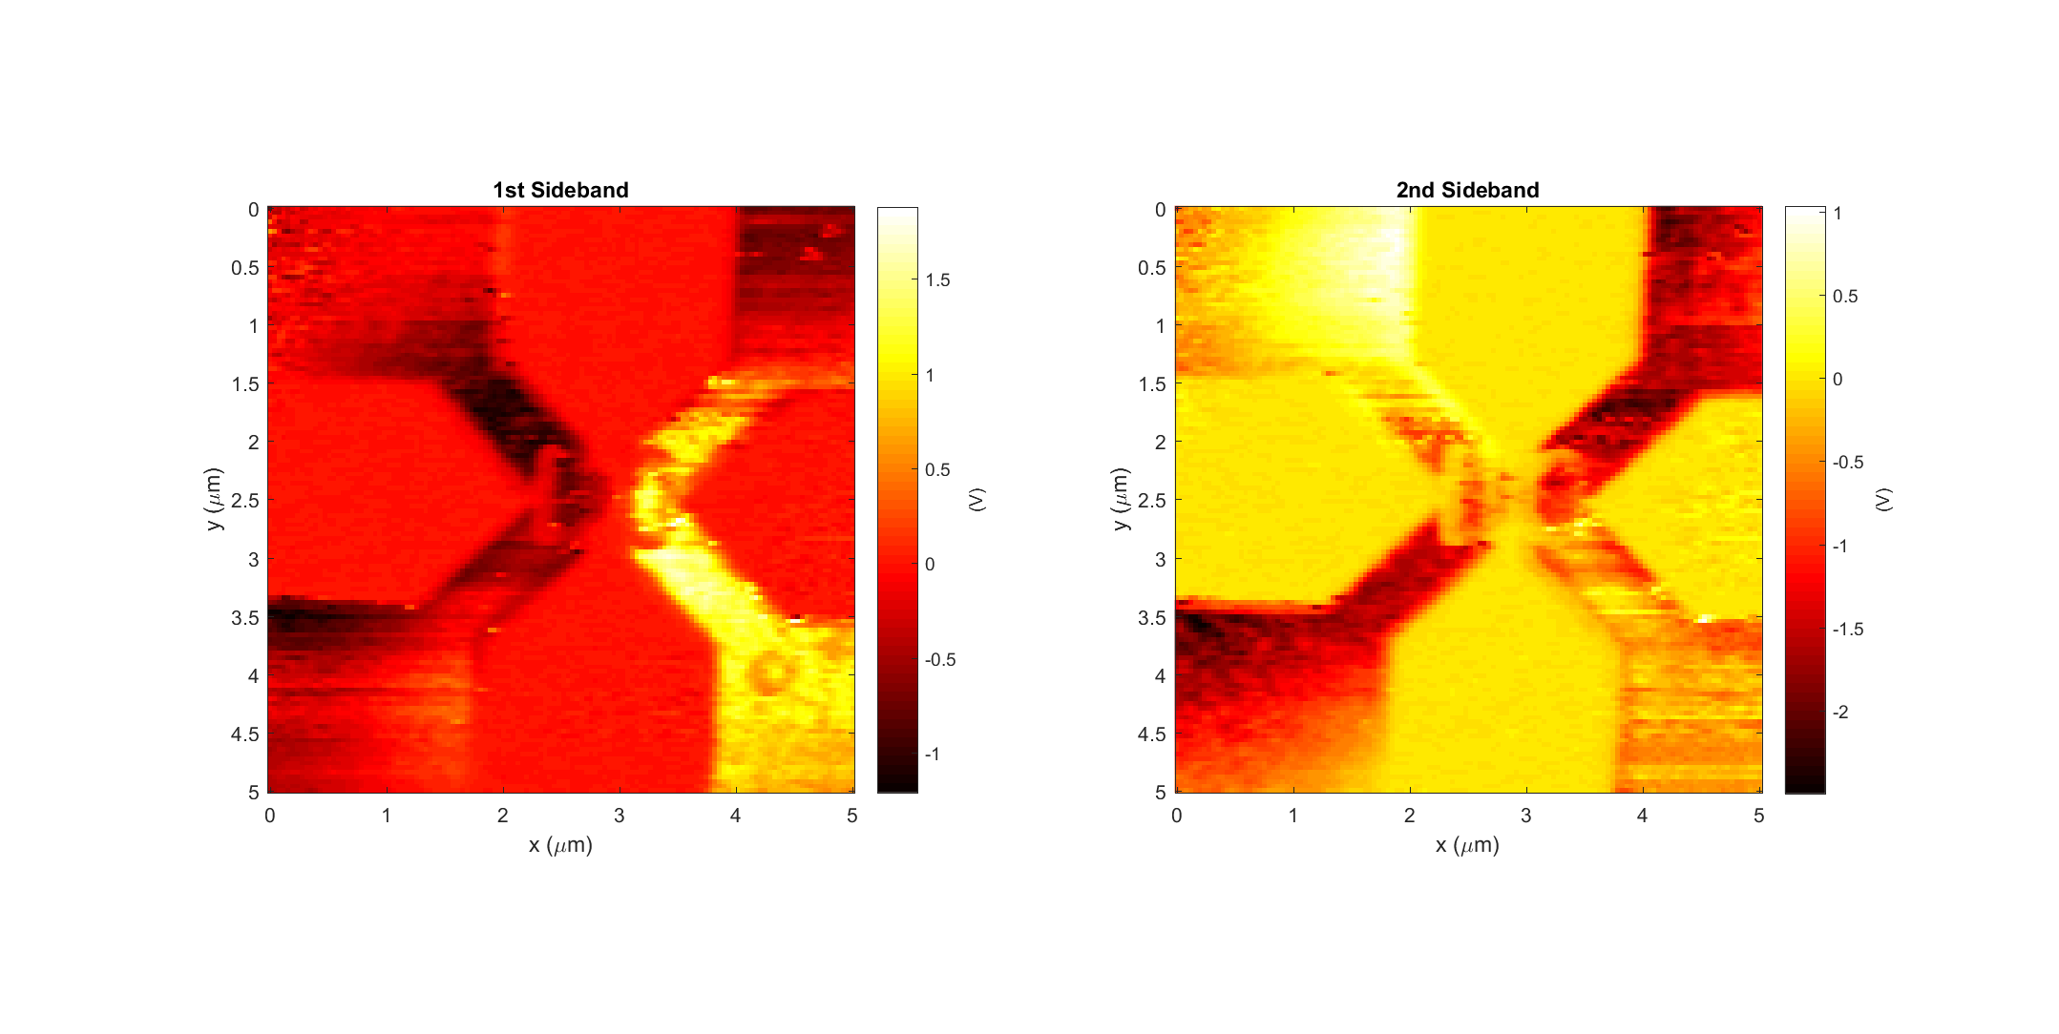
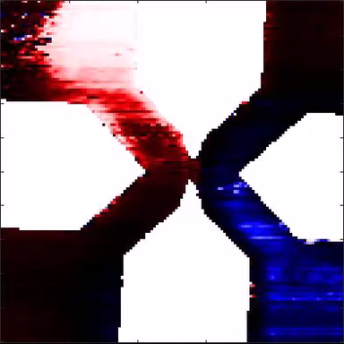
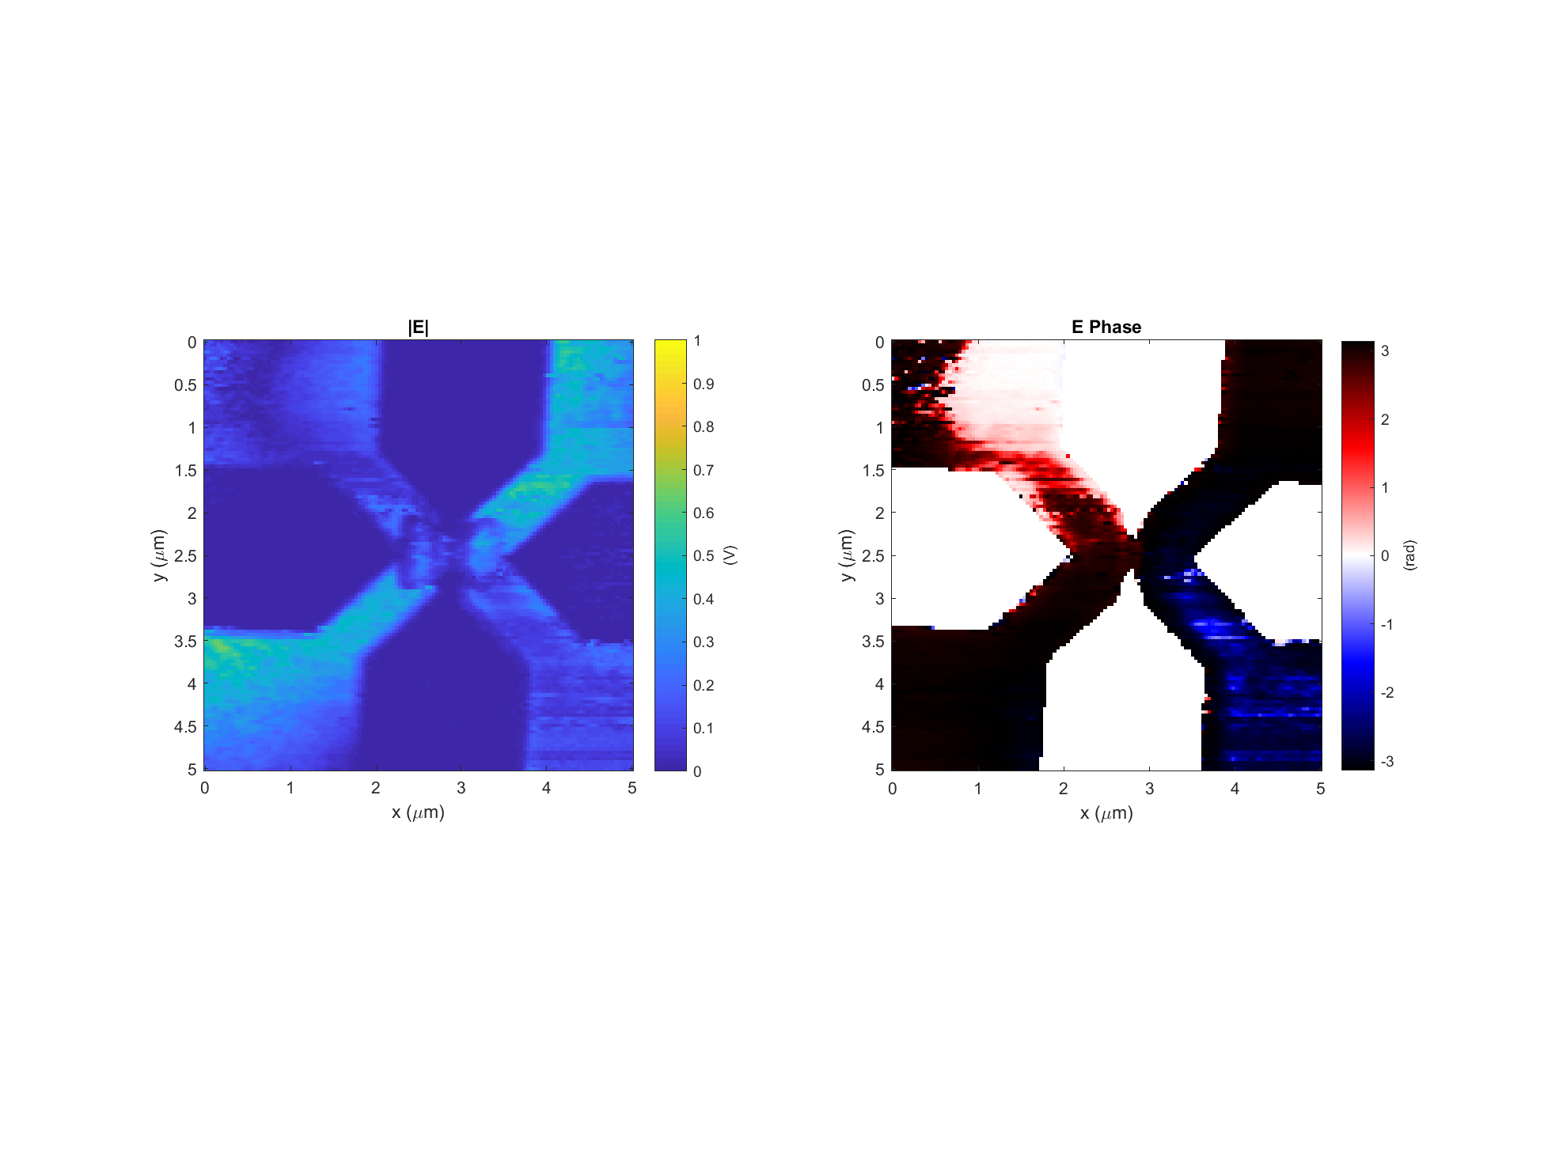
Diode h #3 (good diode) Data: 2017-11-20_diode_h_3_PH_X_3
k
Light incident from below

Slide 8
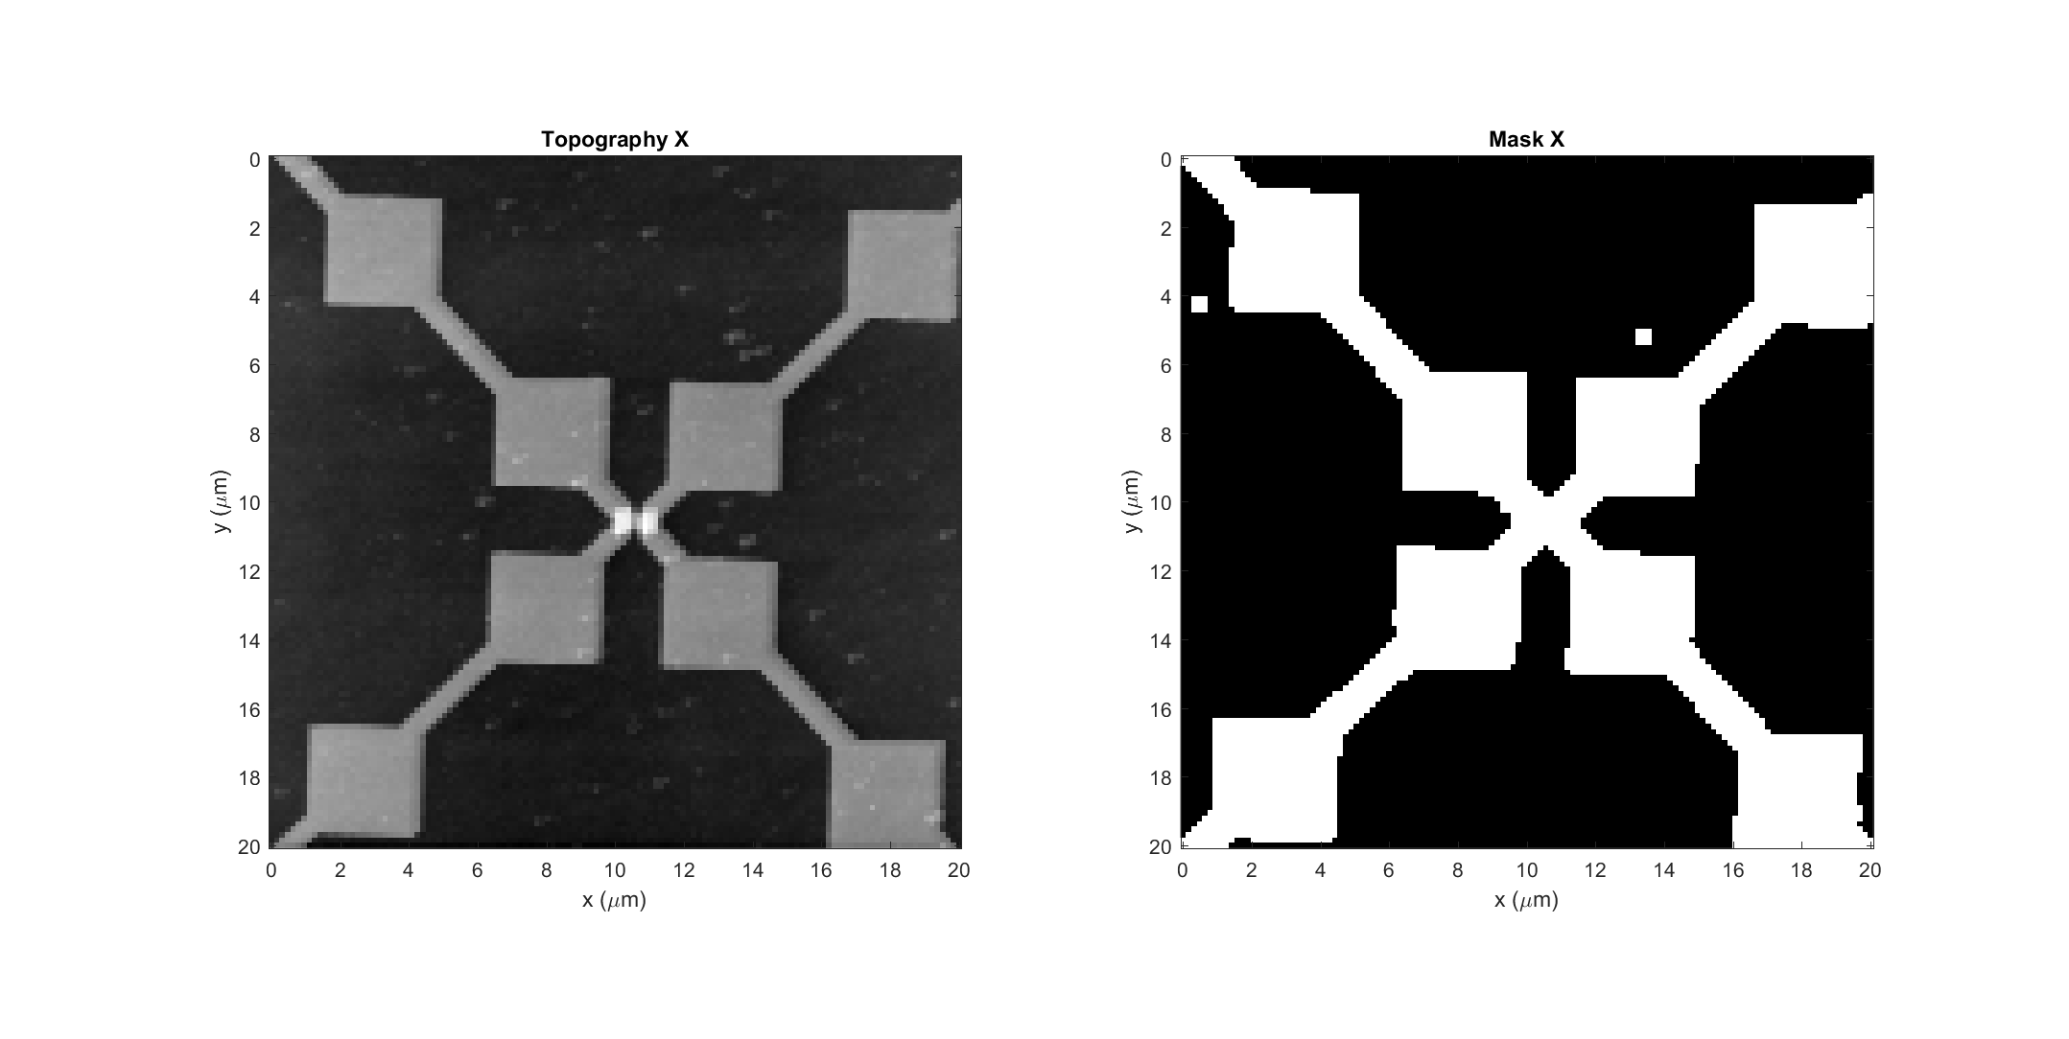
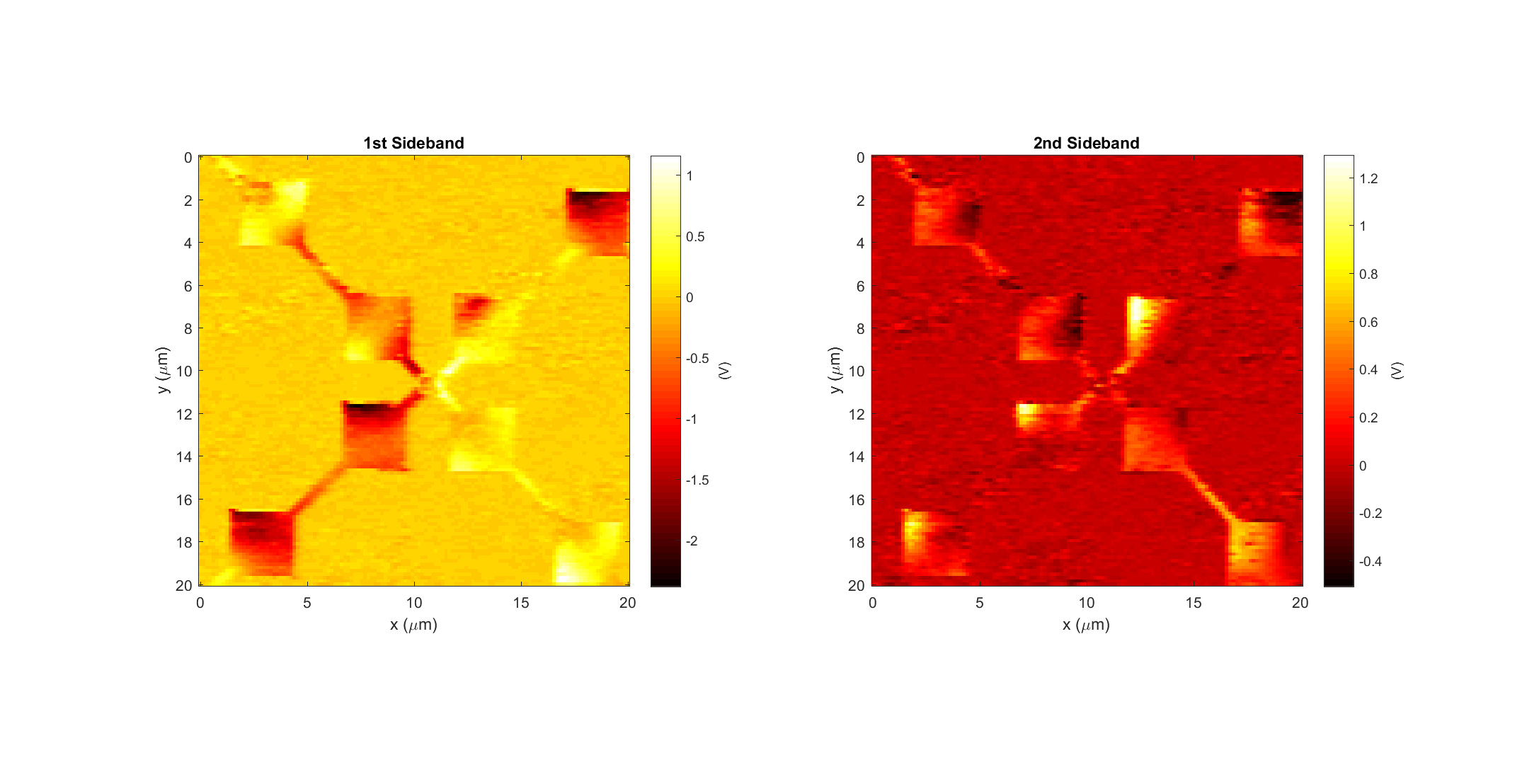
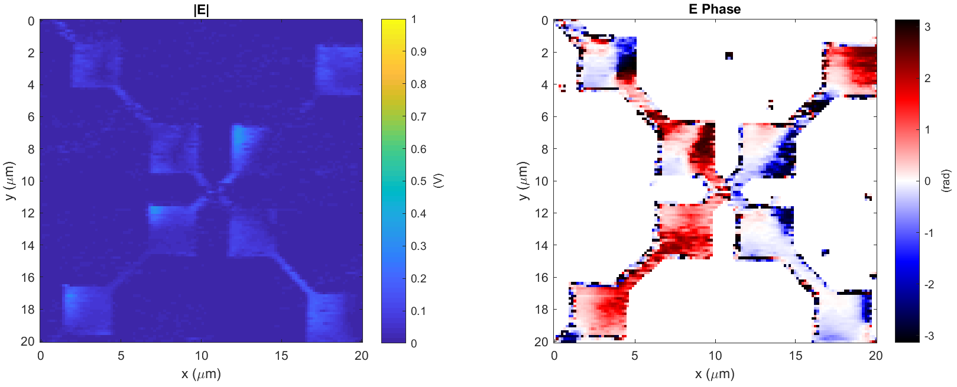
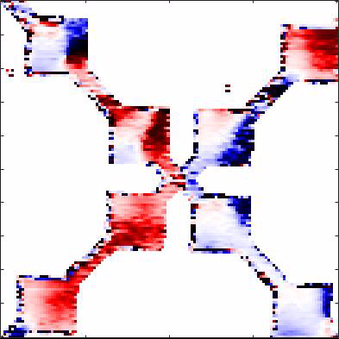
Diode h #4 (good diode) Data: 2017-11-21_diode_h_4_PH_X_1
k
Light incident from below

Slide 9
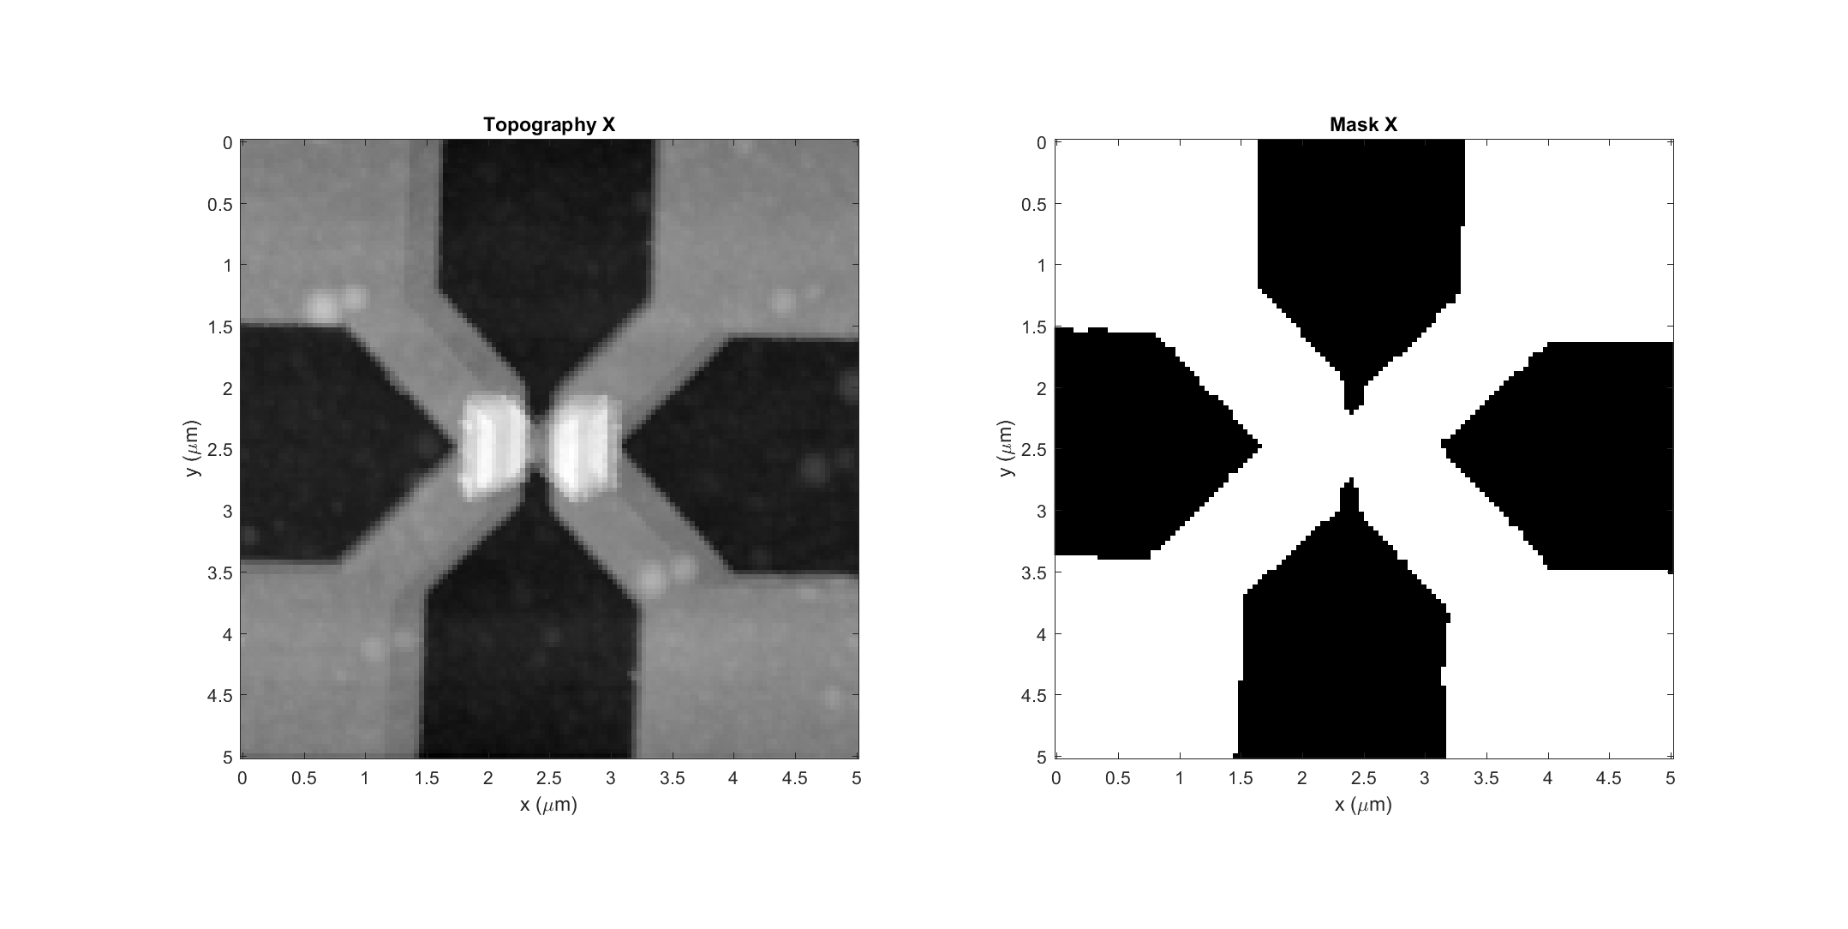
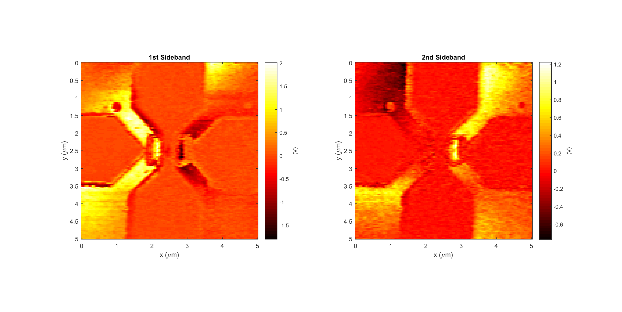
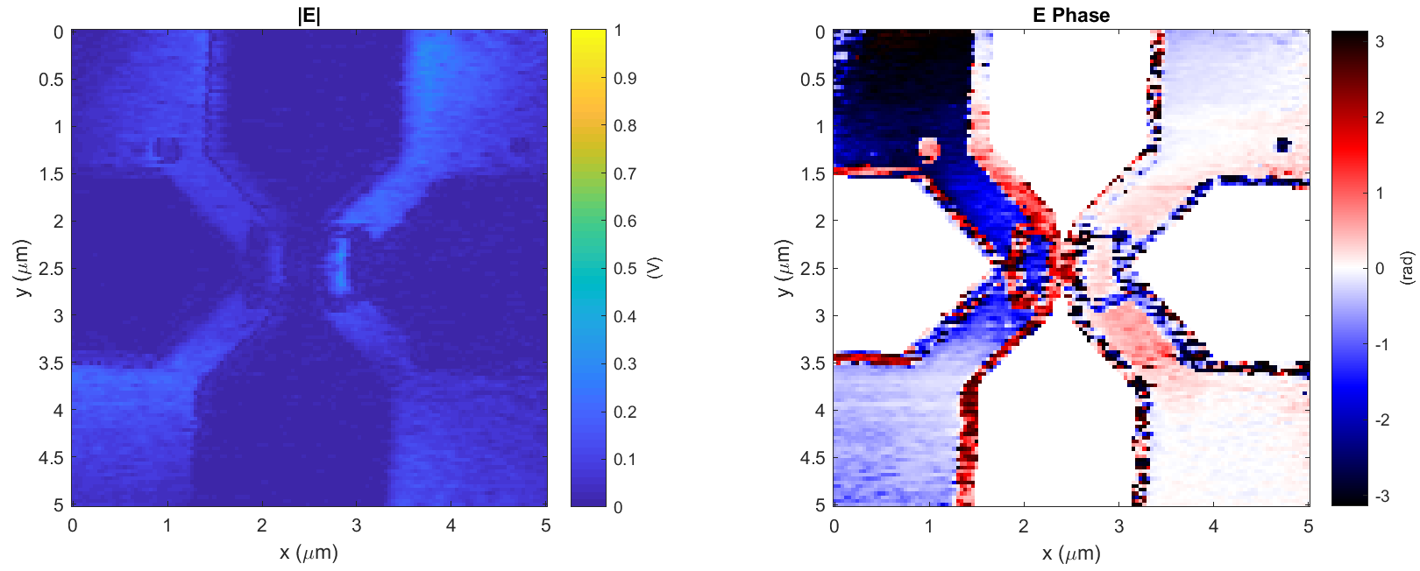
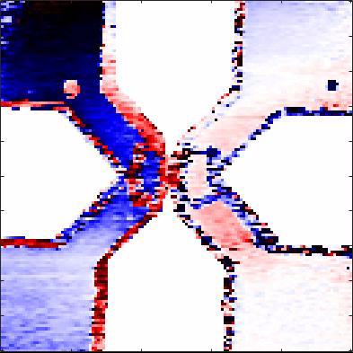
Diode h #4 (good diode) Data: 2017-11-21_diode_h_4_PH_X_3
k
Light incident from below

Slide 10
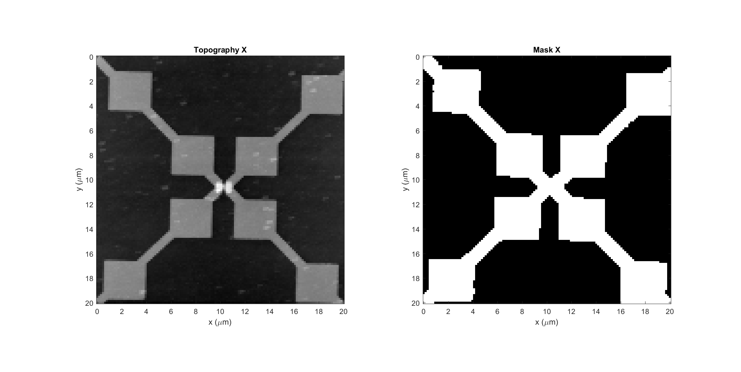
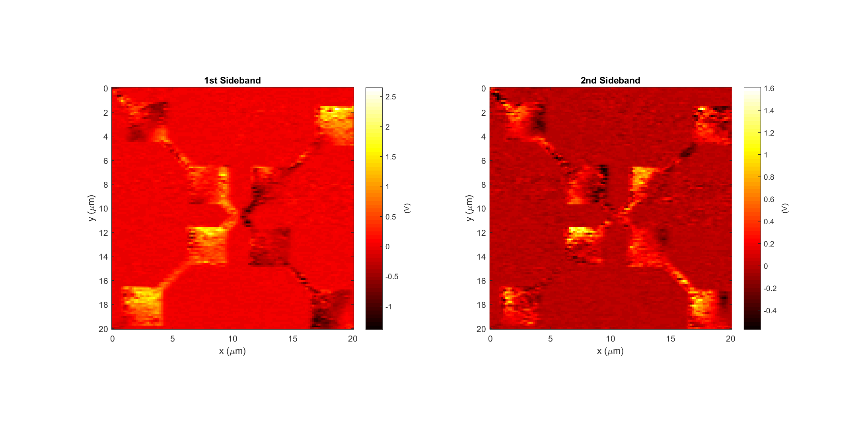
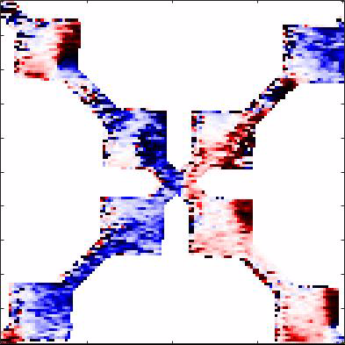
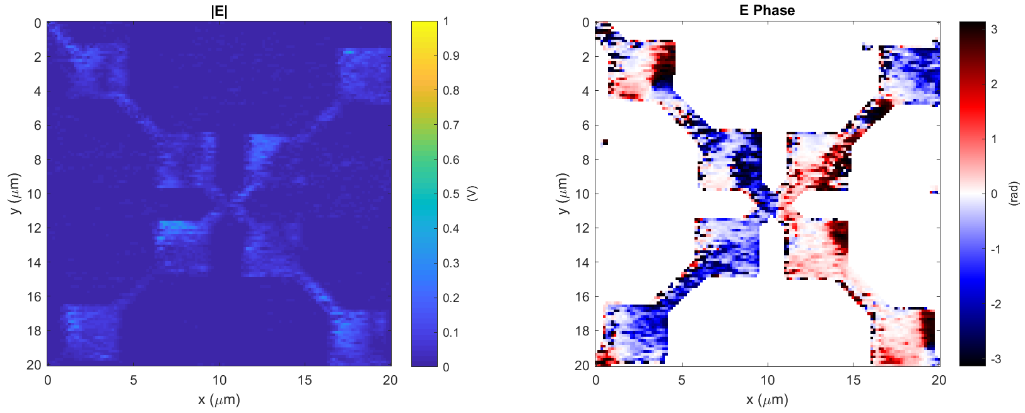
Diode h #5 (good diode) Data: 2017-11-21_diode_h_5_PH_X_1
k
Light incident from below

Slide 11
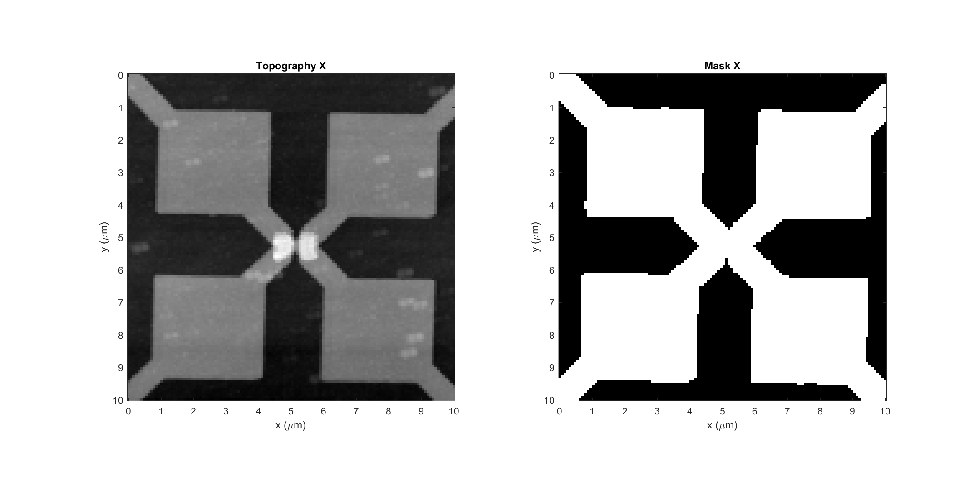
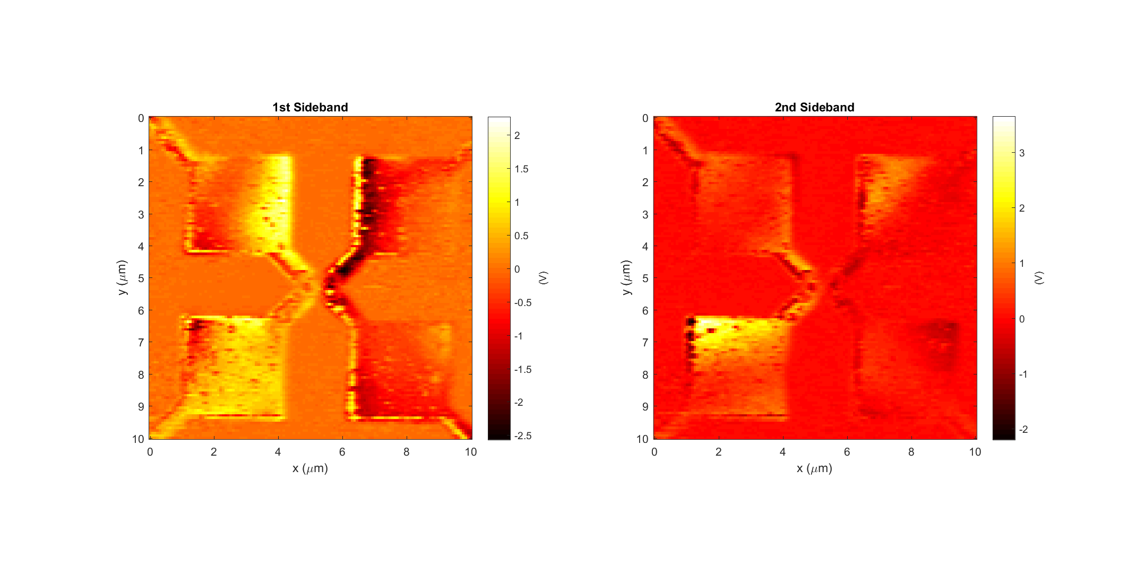
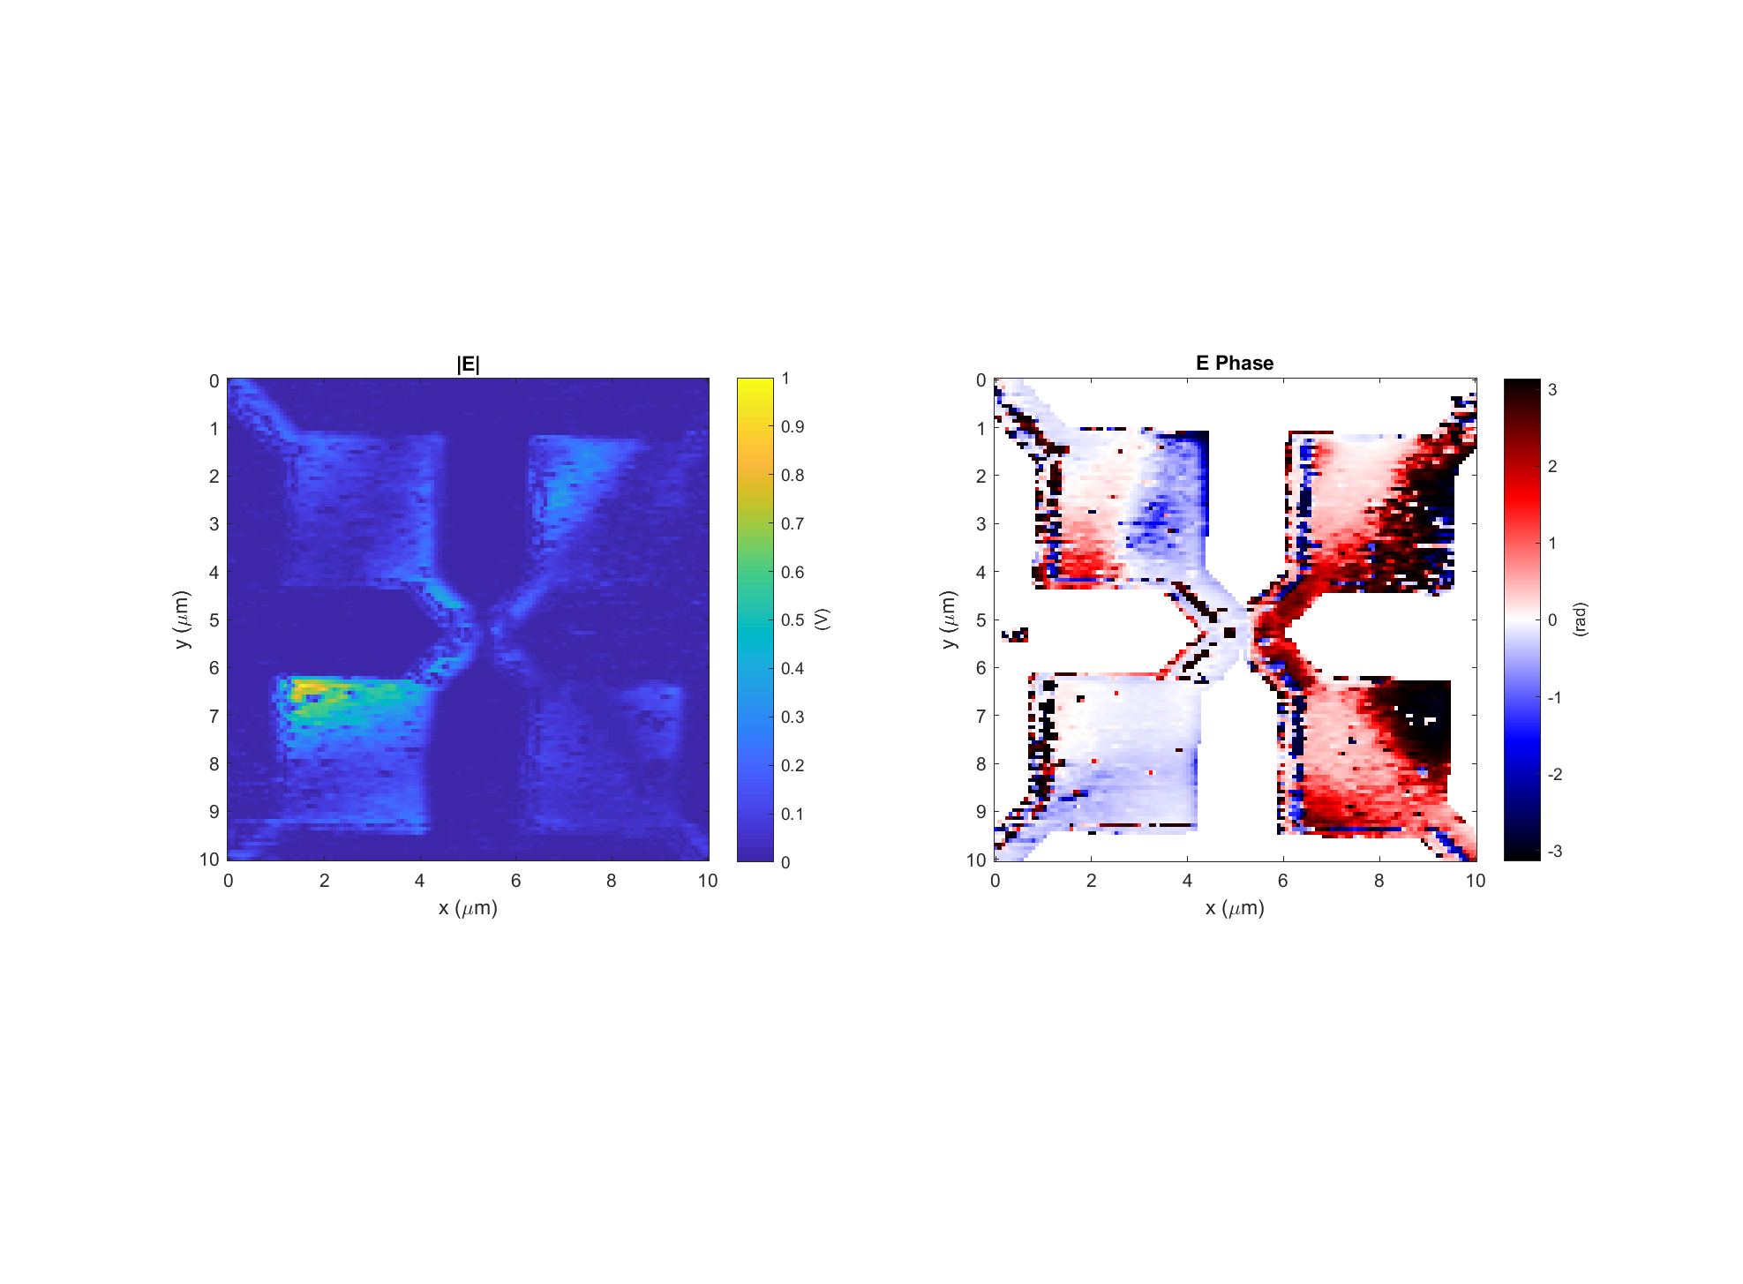
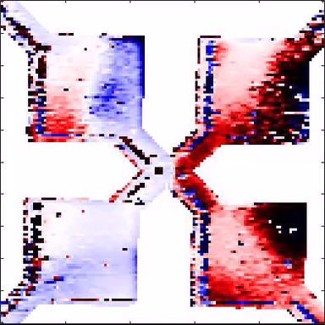
Diode h #5 (good diode) Data: 2017-11-21_diode_h_5_PH_X_3
k
Light incident from below

Slide 12
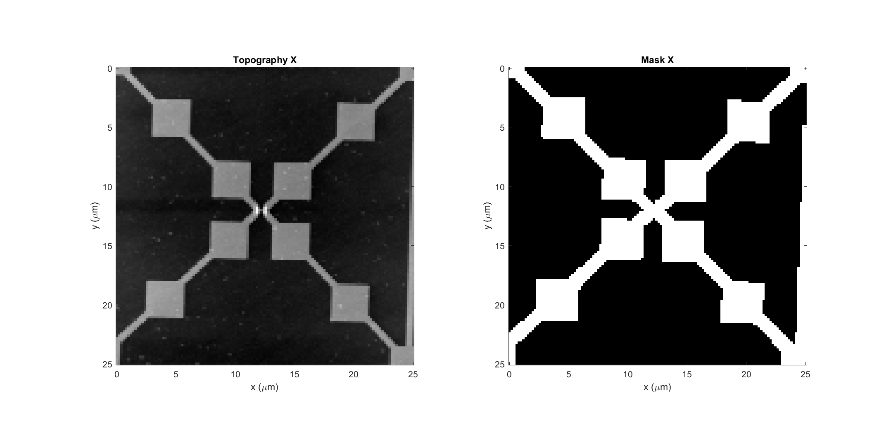
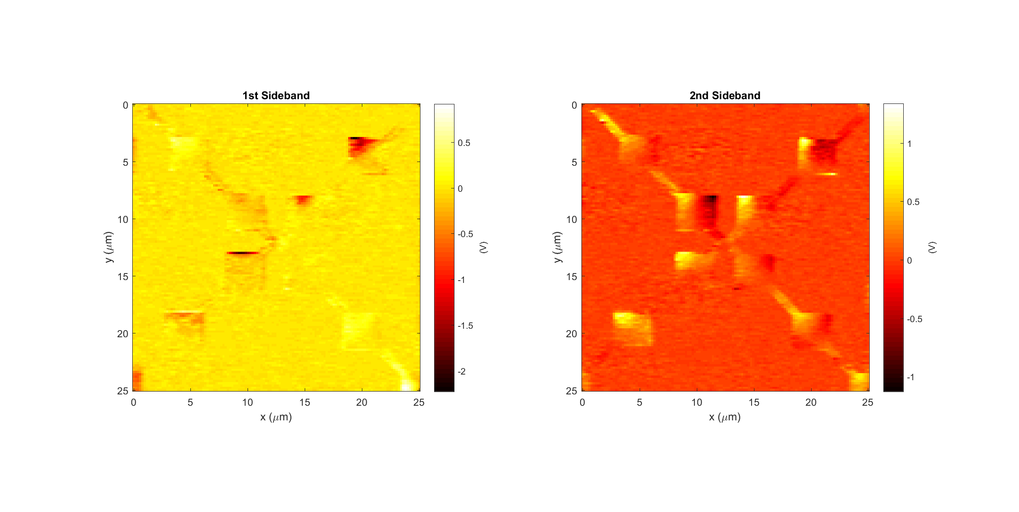
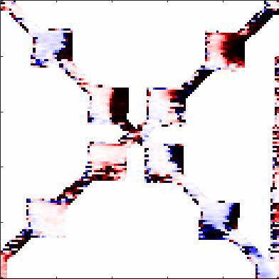
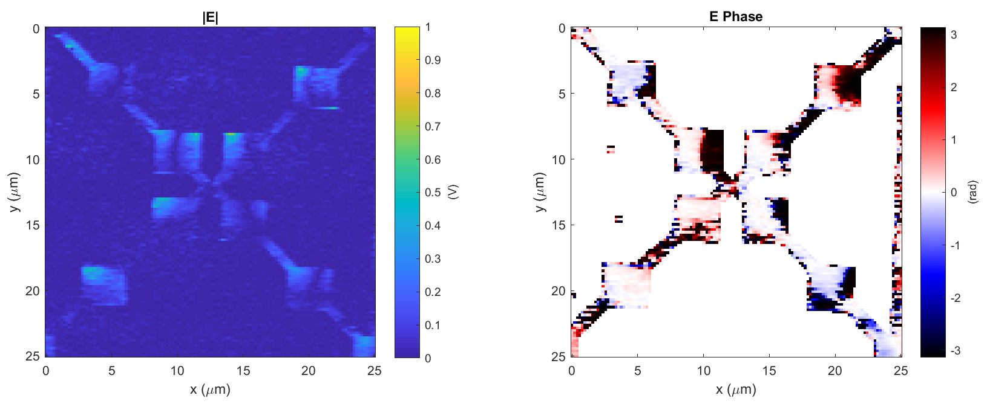
Diode g #1 (bad diode) Data: 2017-12-07_diode_g_1_PH_X_1
k
Light incident from below

Slide 13
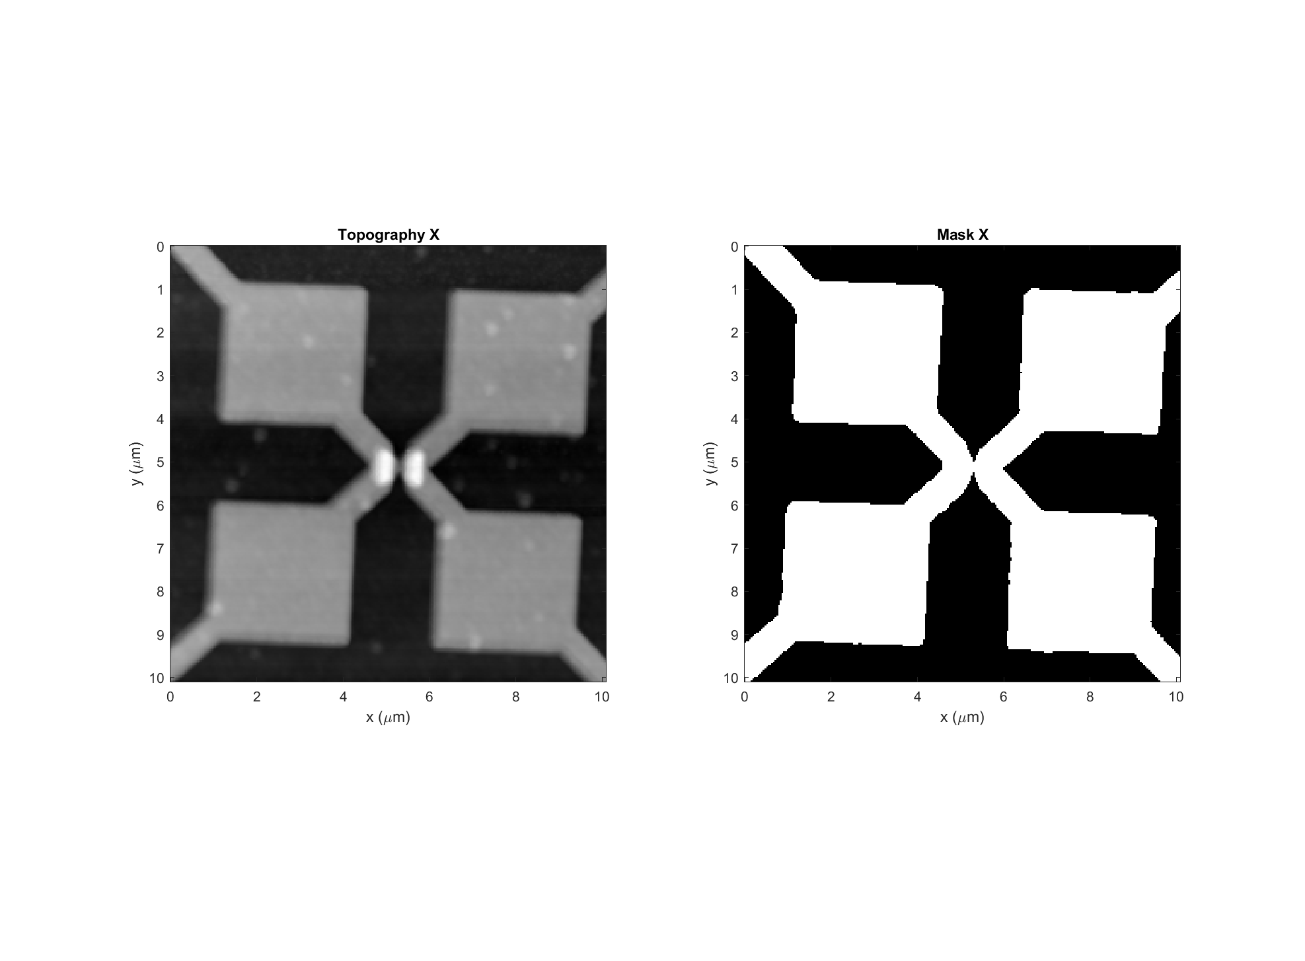
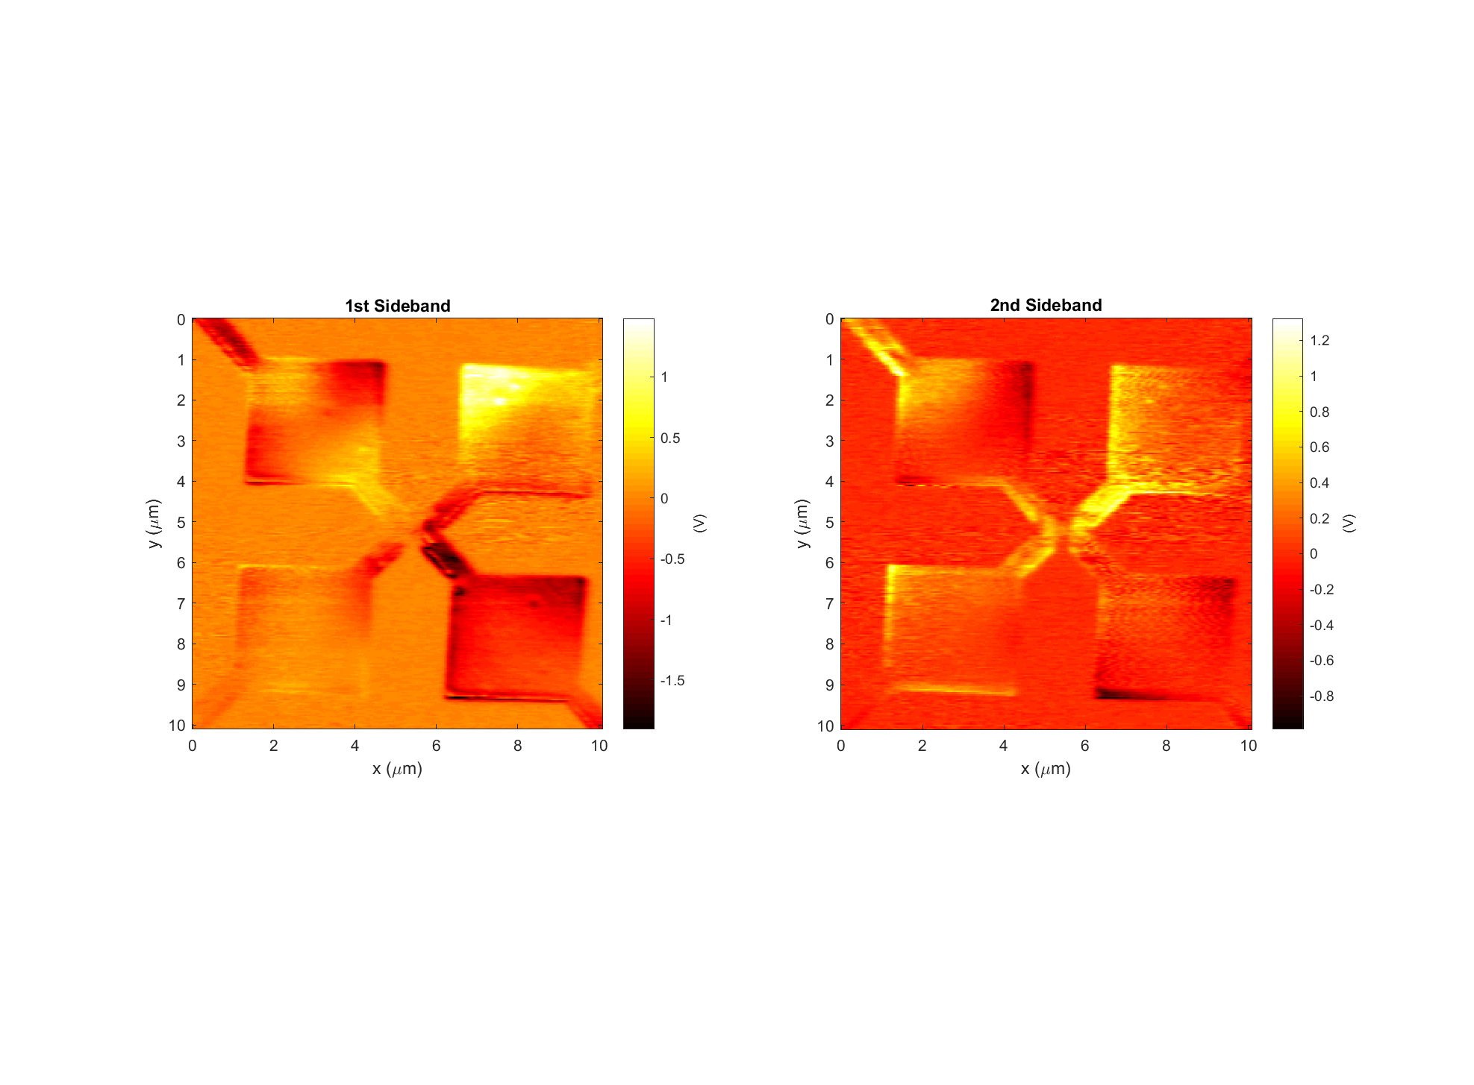
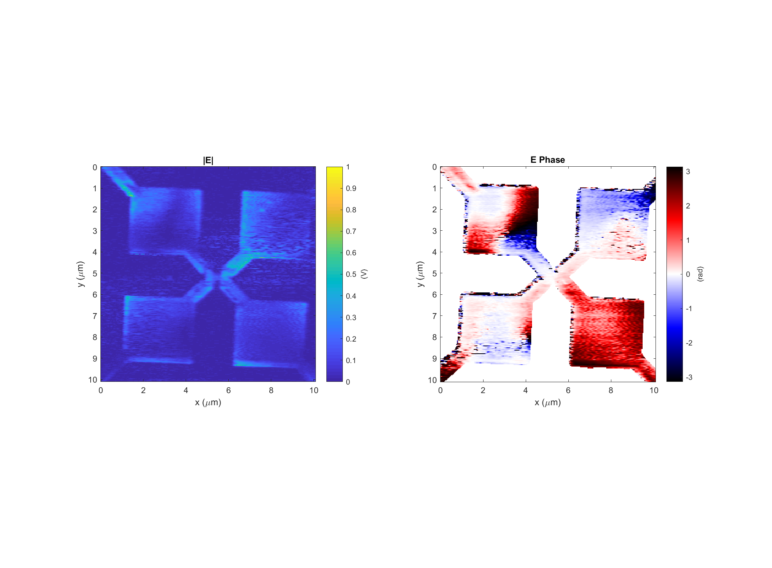
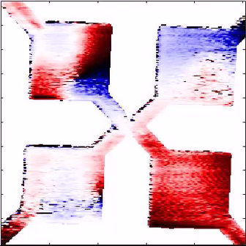
Diode g #1 (bad diode) Data: 2017-12-12_diode_g_1_PH_X_3
k
Light incident from below

Slide 14
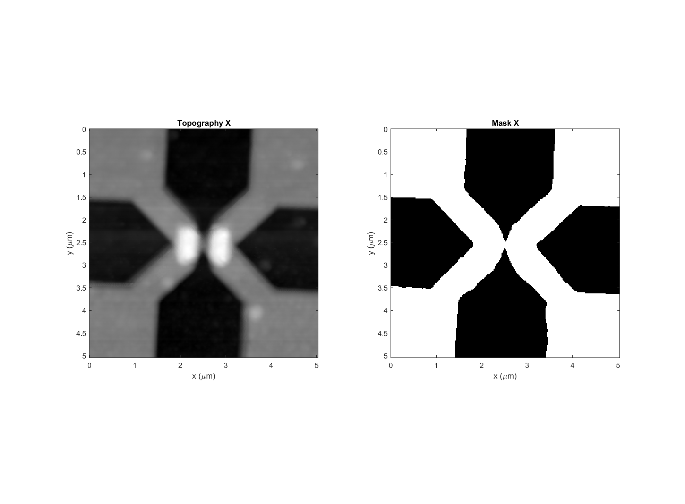
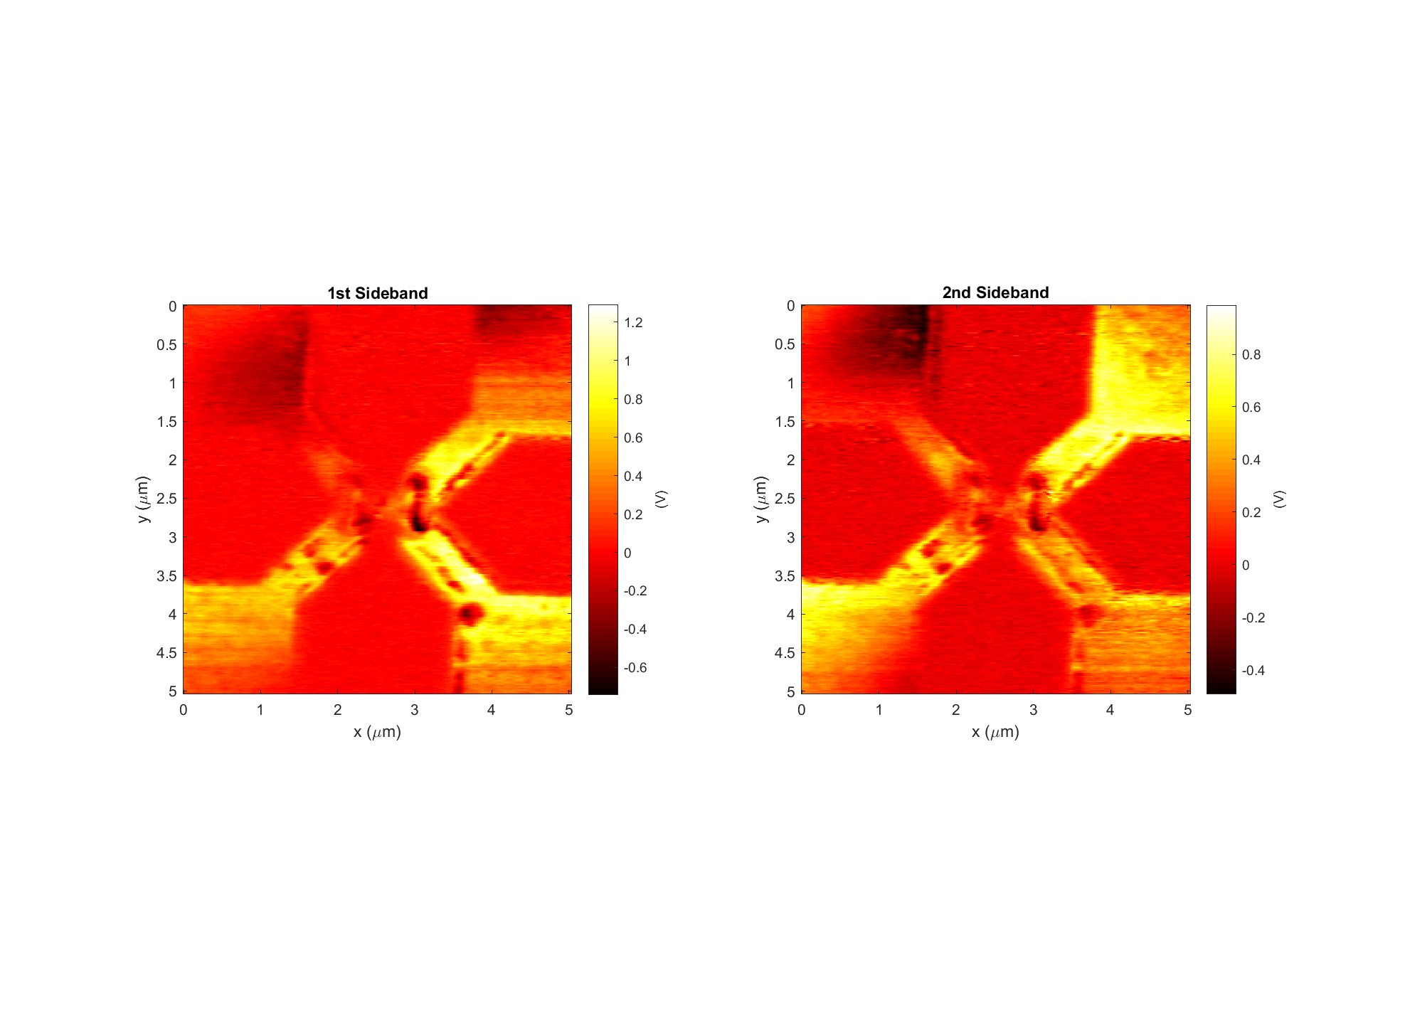
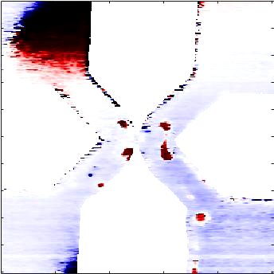
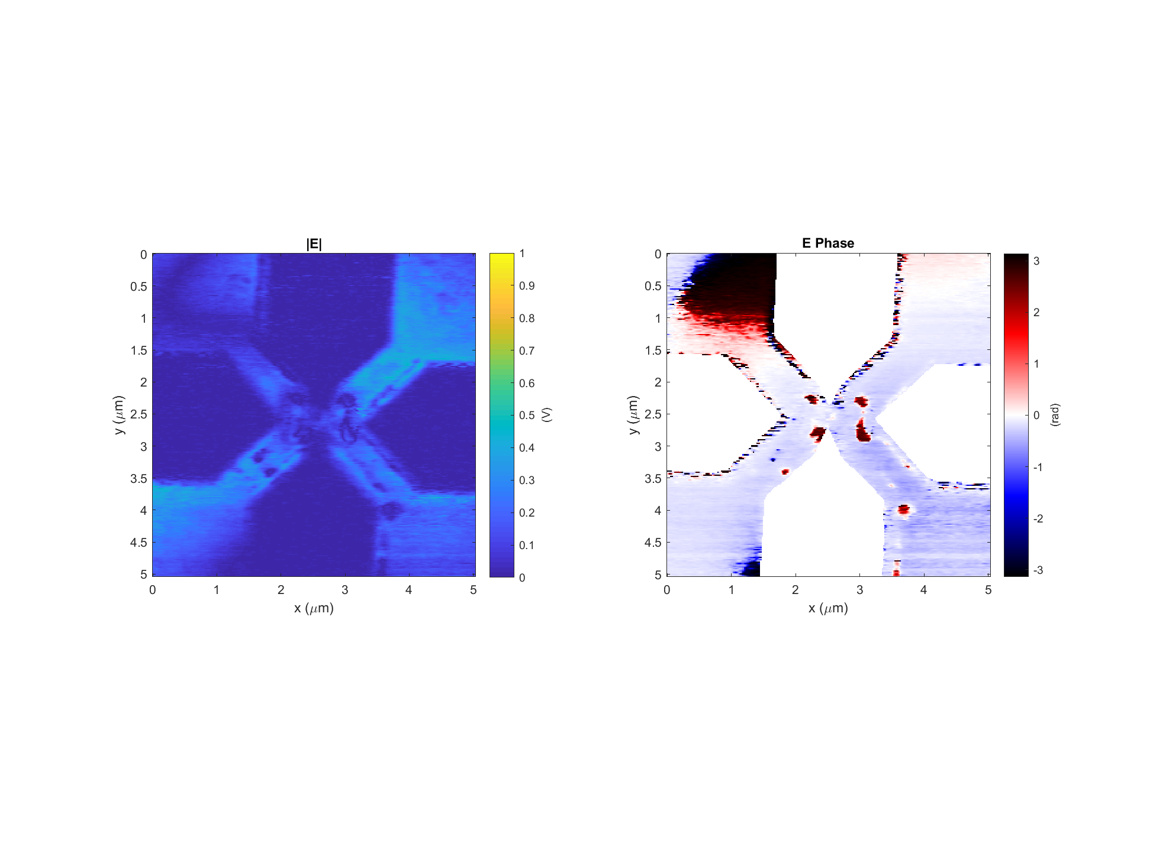
Diode g #1 (bad diode) Data: 2017-12-12_diode_g_1_PH_X_4
k
Light incident from below

Slide 15
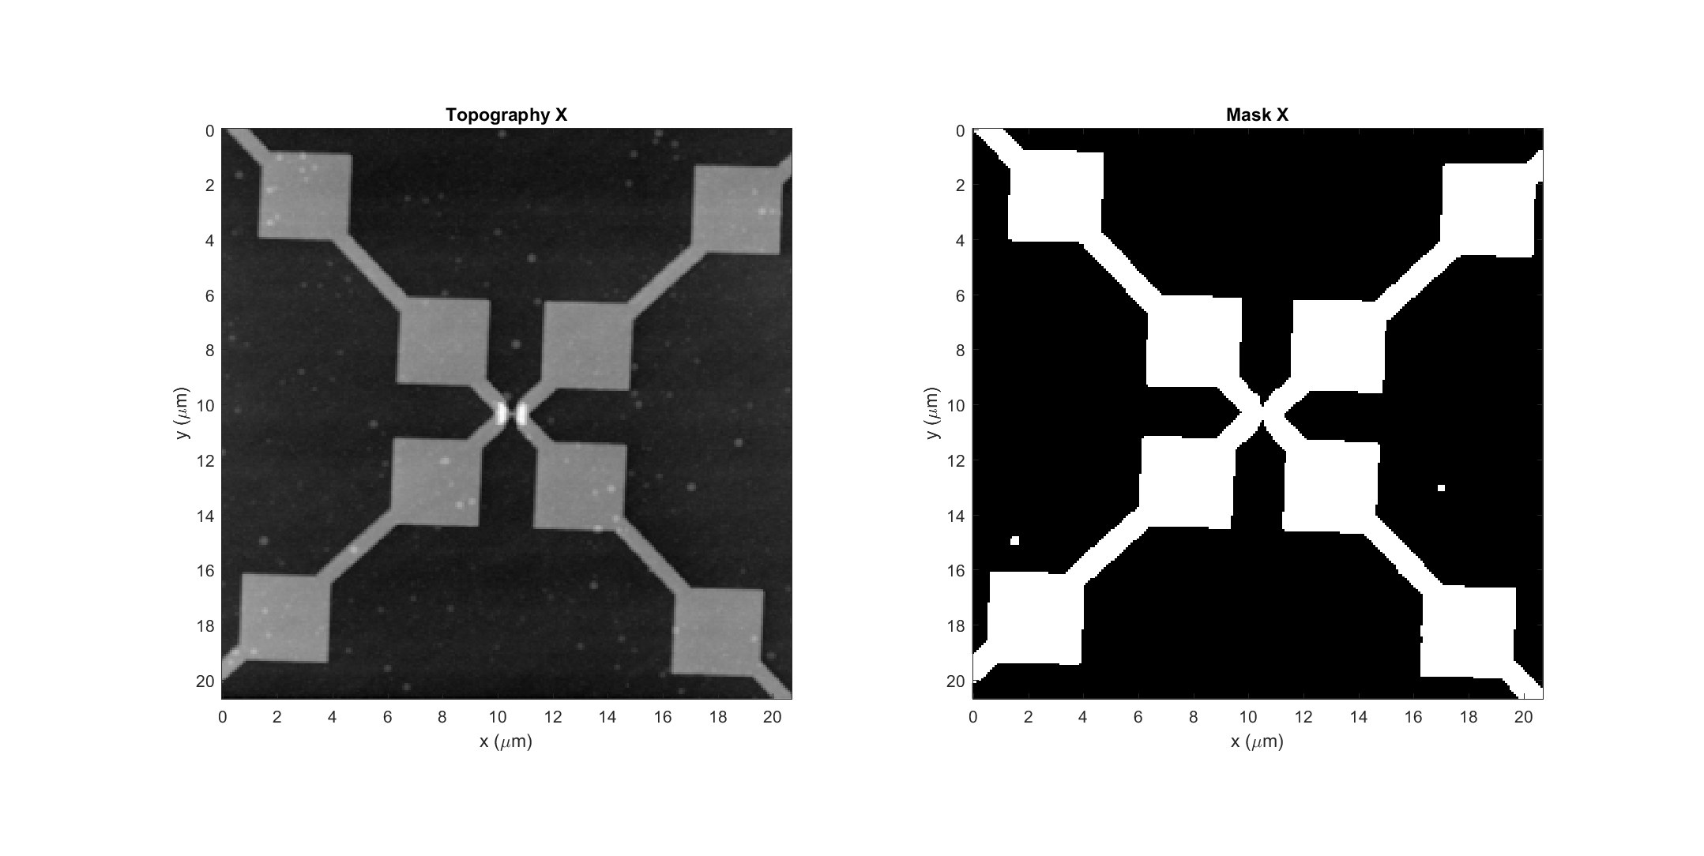



Diode g #2 (bad diode) Data: 2017-12-07_diode_g_2_PH_X_4
k
Light incident from below

Slide 16




Diode g #2 (bad diode) Data: 2017-12-12_diode_g_2_PH_X_2
k
Light incident from below

Slide 17




Diode h #1 (bad diode) Data: 2017-12-13_diode_h_1_PH_X_1
k
Light incident from below

Slide 18




Diode h #1 (bad diode) Data: 2017-12-13_diode_h_1_PH_X_2
k
Light incident from below

Slide 19




Diode h #7 (bad diode) Data: 2017-12-13_diode_h_7_PH_X_2
k
Light incident from below

Slide 20




Diode h #7 (bad diode) Data: 2017-12-13_diode_h_7_PH_X_3
k
Light incident from below

Slide 21




No Diode Data: 2017-11-21_diode_h_5_PH_X_1
k
Light incident from below

